Slide 1
Closing the Net on Transient Sources
of Ultra-High Energy Cosmic Rays
J. Biteau, J. Bregeon, A. Condorelli, O. Deligny, S. Marafico
Based on:
Biteau, ApJS 256, 15 (2021)
Luce, Marafico, Biteau, Condorelli, Deligny, ApJ 936, 62 (2022)
Condorelli, Biteau, Adam, ApJ 957, 80 (2023)
Marafico, Biteau, Condorelli, Deligny, Bregeon, ApJ 972, 1 (2024)
As part of the ANR & DFG funded project: MultI-messenger probe of Cosmic-Ray Origins (MICRO)
FR PIs: J. Biteau (Univ. Paris Saclay), C. Bérat (LPSC, Grenoble)
DE PIs: K.-H. Kampert (Bergischen Univ. Wuppertal), J. Becker-Tjus (Ruhr Univ. Bochum)
Olivier Deligny

Slide 2
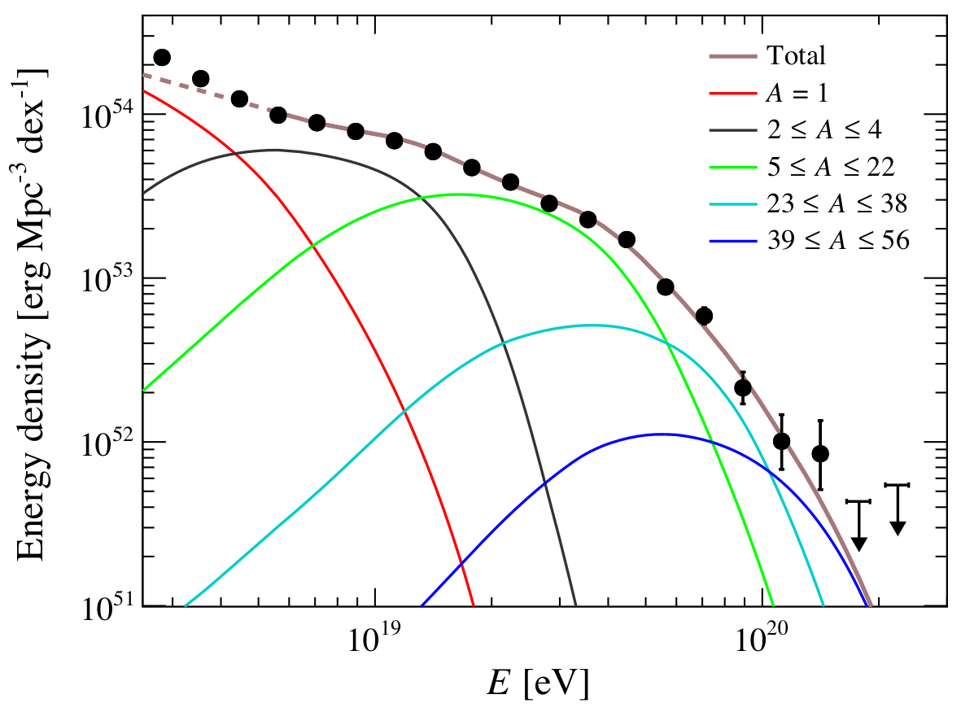
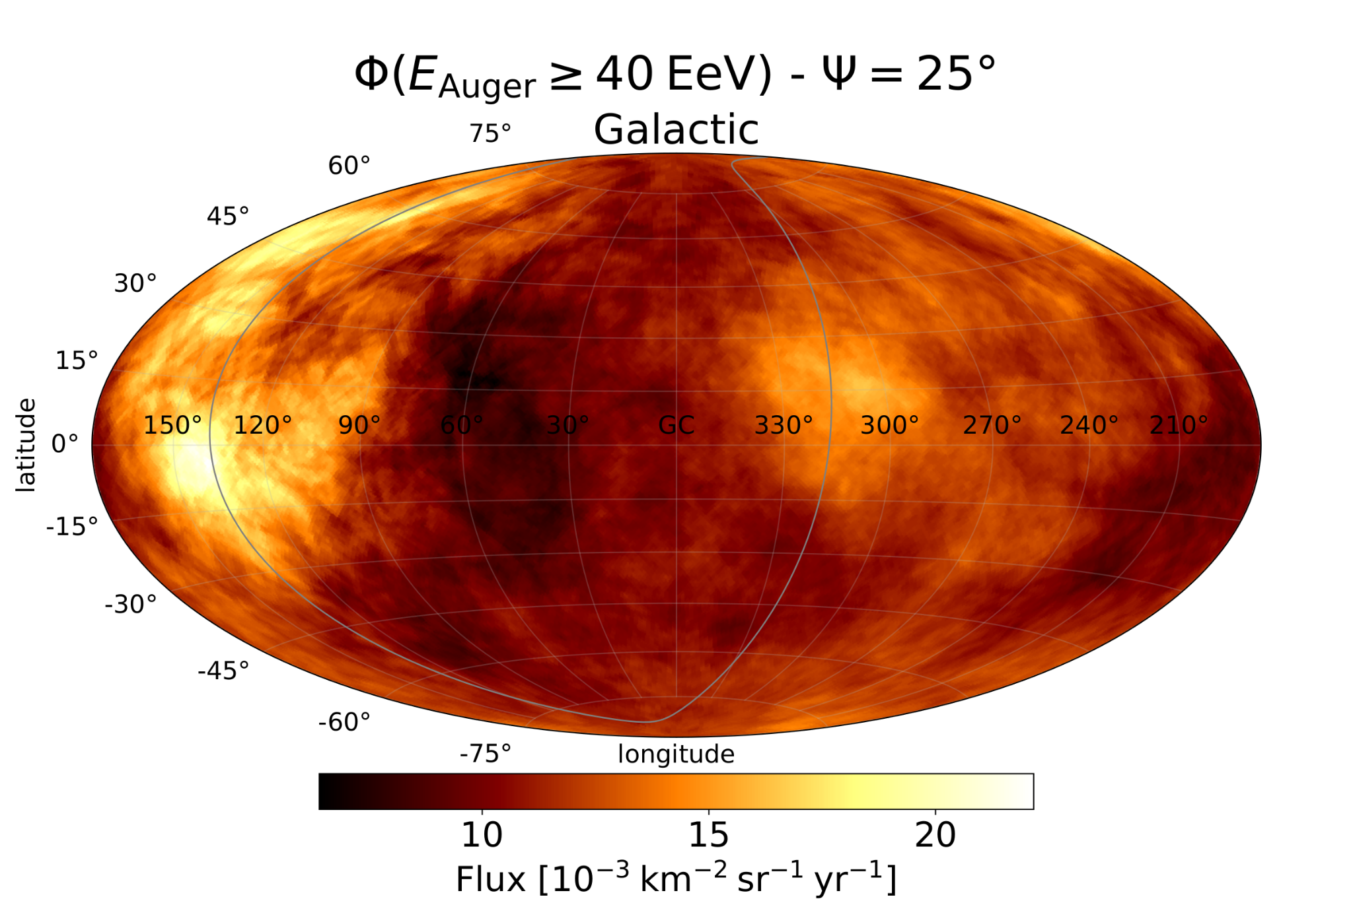
The quest for UHECR origins
Full-sky spectral and composition observables
Constrain UHECR production rate per unit matter: or
Anisotropy observables
Break down the flux vs arrival direction
Ankle
~5 EeV
Instep
~10 EeV
Toe
~40 EeV
Toe
region
Adapted from
Caccianiga+ (Auger+TA) ‘23
Pierre Auger Collab. ‘20

Slide 3
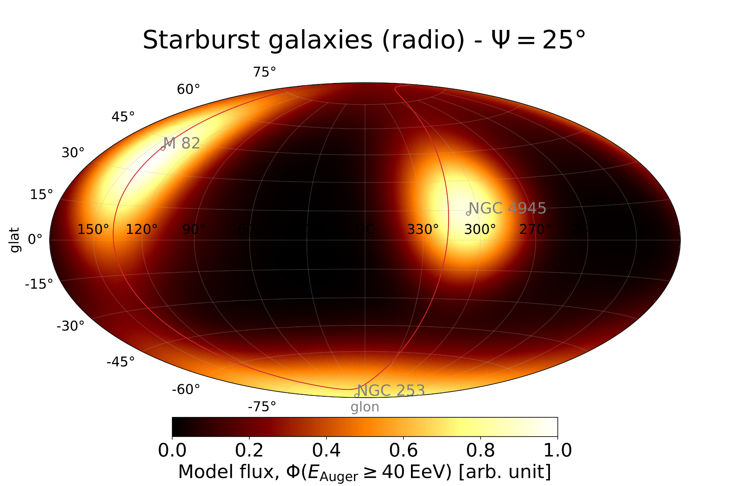
Status of anisotropies @UHE
Cross-correlation with 44 starbursts: evidence of anisotropy in the toe region
Pierre Auger Obs. + Telescope Array Arrival Directions: 4.6σ (Auger + TA, ICRC 2023)
Pierre Auger Obs. Arrival Directions + Spectrum + Composition: 4.5σ (Auger, JCAP 2023)
Why starbursts? Why anisotropic fraction ~ 10%?
Why Gaussian angular scale θ ≈ 15° (⇔ top-hat Ѱ ~ 25°)?
44 star-forming galaxies (SFGs)
~10% excess
Adapted from
Caccianiga+ (Auger+TA) ‘23

Slide 4
Mass composition
Reservoir of heavy elements?
Accelerators located close to exceptional sources of nuclei, e.g. of nucleosynthesis or direct synthesis
Reacceleration of PeV CRs
Ankle
~5 EeV
Instep
~10 EeV
Toe
~40 EeV
Metallicity poorly constrained (p secondaries/primaries?)
Material from (high-mass) stars He/Heavy nuclei (Marafico+ ‘24)
would be 18 ± 2 if ISM picked-up material
+ good agreement of heavy to intermediate-mass nuclei with
composition of massive stars stripped of their H-He envelopes
(0.30 ± 0.05 stat. ± 0.10 sys. vs 0.53 ± 0.09)
Lodders 09, Zhang, Murase, Oikonomou ‘17
Pierre Auger Collab. ‘20

Slide 5
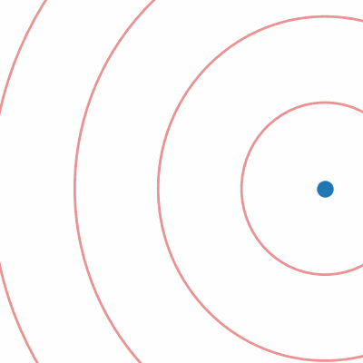
Starbursts host more frequent stellar explosions…
Just a tracer of SFR or stellar mass M*
SFR/M* tracer of cataclysmic events, death of massive stars
Transient scenario by essence
Source with burst rate λ invisible:
B = 0
B > 0
2d_{min}
Source
Credit: S. Marafico
UHECR burst

Slide 6
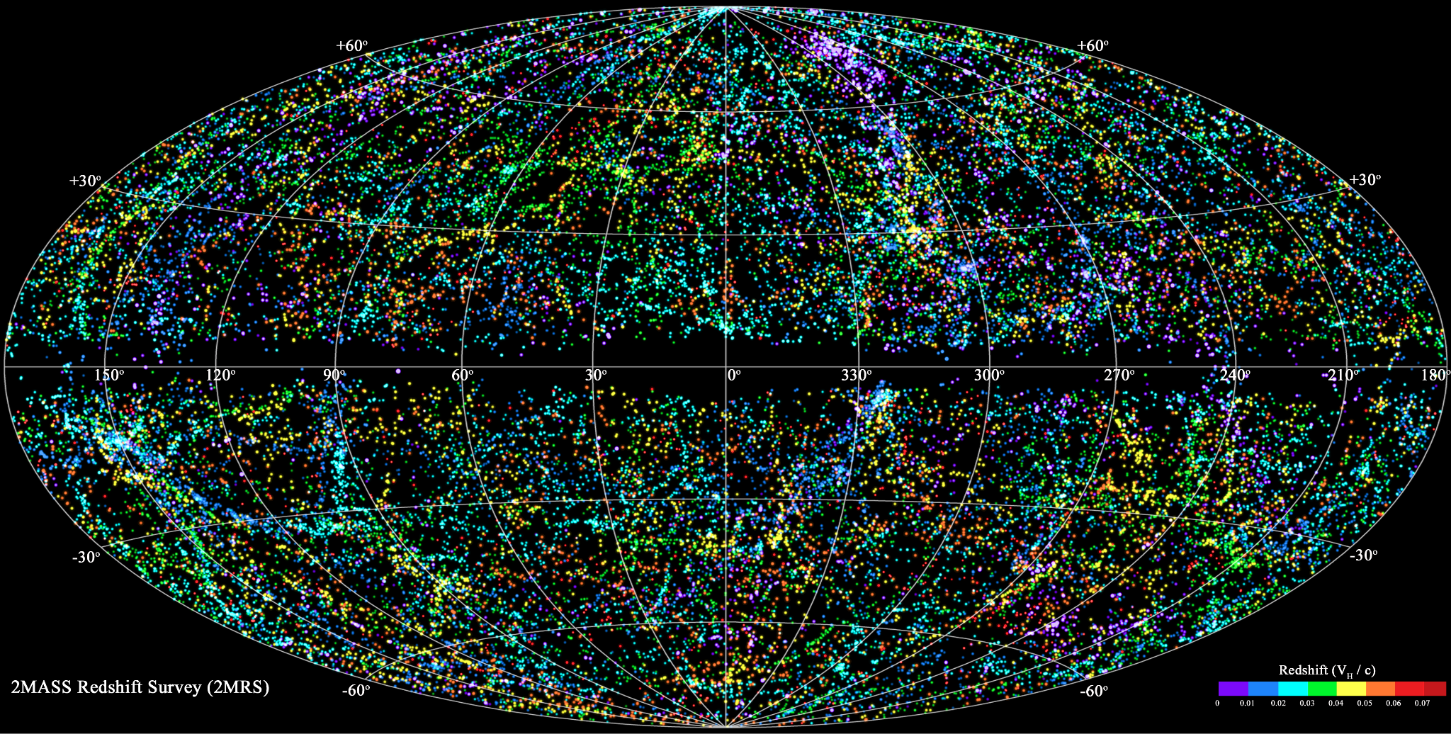
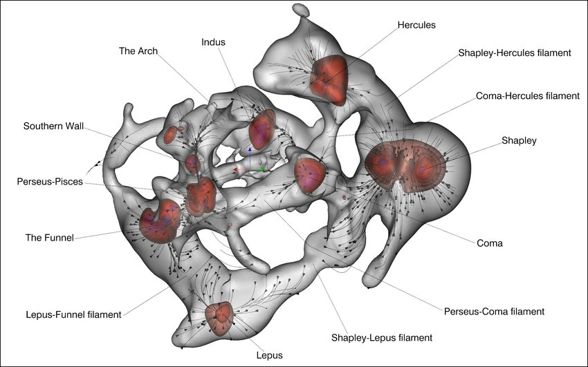
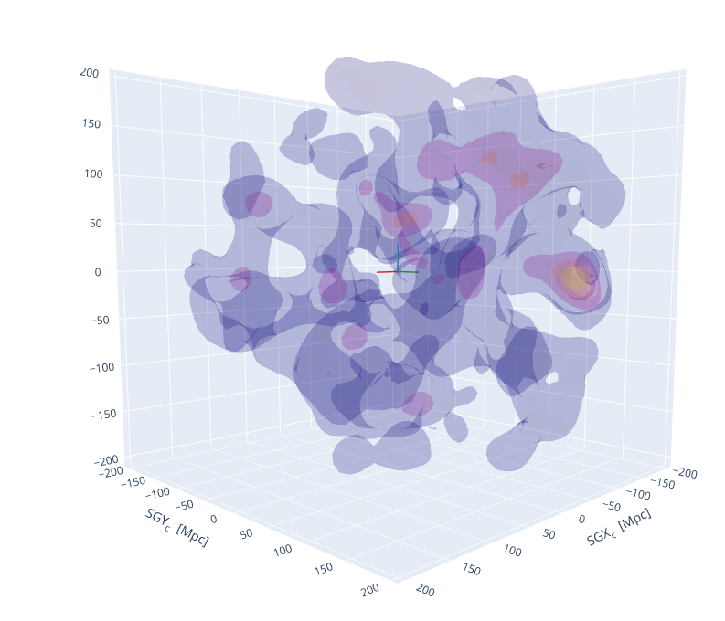
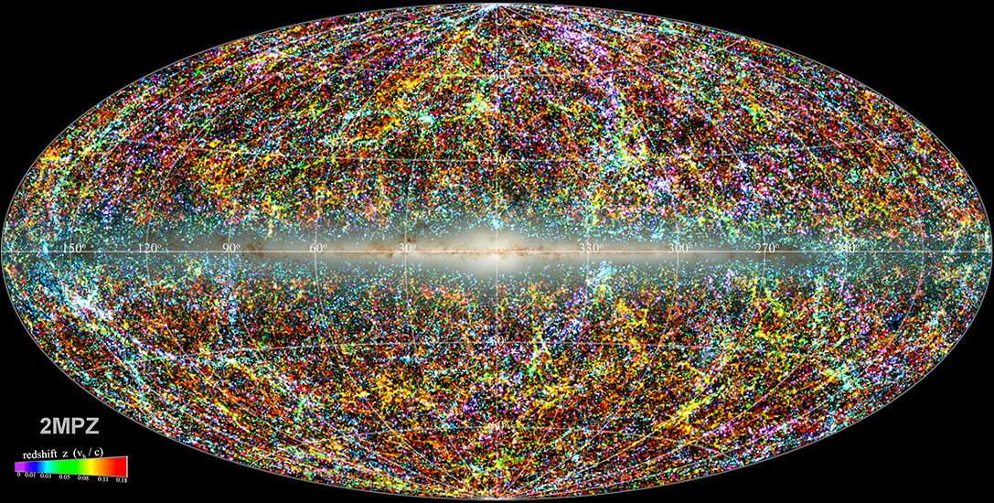
Mapping out stellar matter in the GZK horizon
( 2MASS Photometric z catalog ⋂ WISE ) ✖ HyperLEDA (Biteau, ApJS ‘21)
Near IR flux-limited sample mapping both SFR and stellar mass over 90% of the sky
Credits: 2MRS, Huchra+ ‘12
Cosmic V-web, Pomarède+ 2017
~8k galaxies
2MRS
~45k galaxies
Catalog of 400k galaxies out to d_{max} = 350 Mpc
Completeness in M*: 50% at d_{max} (× 2 wrt 2MRS)
Distances estimated with a 50 − 50 ratio of spectroscopic and photometric measurements
Greatest granularity to date of the density of matter in the entire 350-Mpc radius volume
>100 Mpc, convergence of SFR and M* densities towards measurements of deep-fields values
~400k galaxies
Credits: 2MPZ, Bilicki & Jarret ‘14
JB ‘21
JB ‘21 ⊂ 2MPZ
~400k galaxies

Slide 7
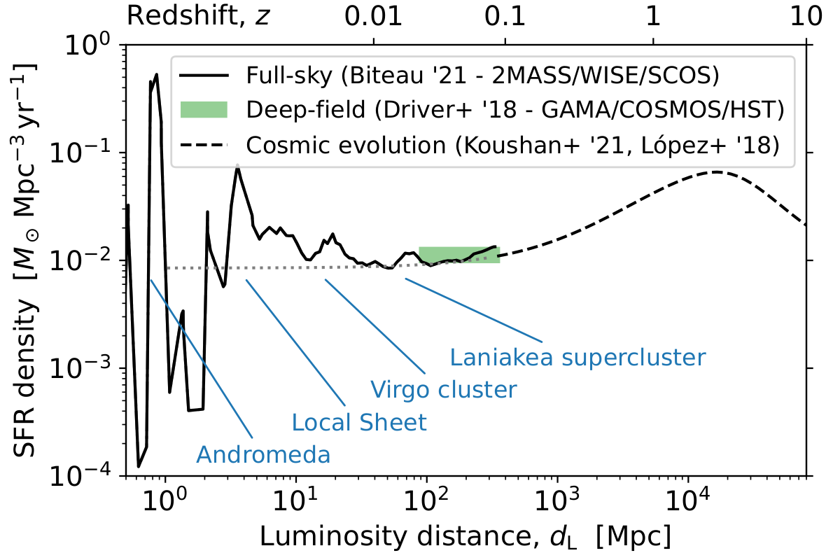
Mapping out stellar matter in the GZK horizon
( 2MASS Photometric z catalog ⋂ WISE ) ✖ HyperLEDA (Biteau, ApJS ‘21)
Credits: 2MRS, Huchra+ ‘12
Cosmic V-web, Pomarède+ 2017
~8k galaxies
2MRS
~45k galaxies
Catalog of 400k galaxies out to d_{max} = 350 Mpc
Completeness in M*: 50% at d_{max} (× 2 wrt 2MRS)
Distances estimated with a 50 − 50 ratio of spectroscopic and photometric measurements
Greatest granularity to date of the density of matter in the entire 350-Mpc radius volume
>100 Mpc, convergence of SFR and M* densities towards measurements of deep-fields values
~400k galaxies
Credits: 2MPZ, Bilicki & Jarret ‘14
JB ‘21
JB ‘21 ⊂ 2MPZ
~400k galaxies

Slide 8
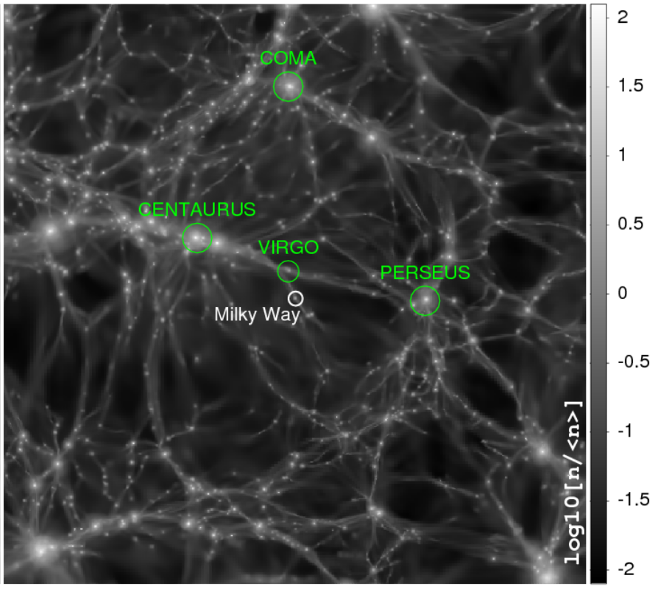
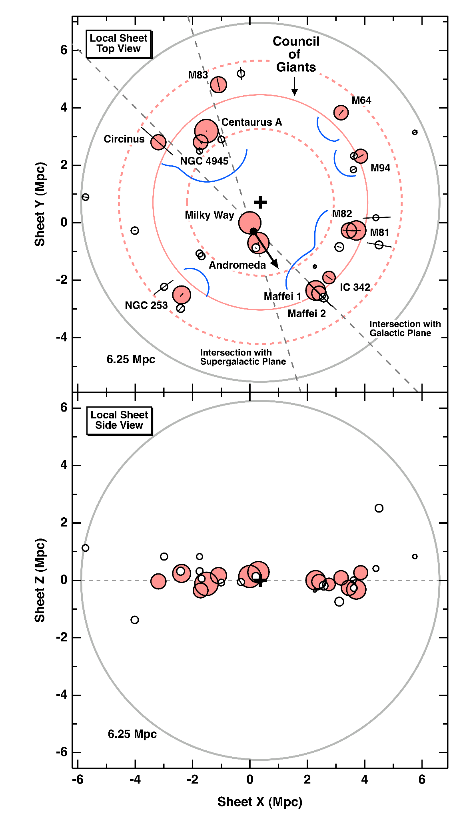
Magnetic fields
Cluster: B ~ 1-10 µG
e.g. Bonafede+ ‘10
Filament: B ~ 10-100 nG
Radio and X- ray stacking of galaxy
filaments, Vernstrom+ ‘21,
Faraday rotation, Carretti+ ‘22
Sheet: B?
200 Mpc
Void: B < 10 pG
Jedamzik & Saveliev ‘19,
Vazza+ ‘17
Our location:
The Local Sheet
Assume warm-hot plasma with properties similar to those of clusters
turbulent B field filling the Local Group with λ ~ λ_{clusters} and B_{rms} to be determined
McCall ‘14
Credit: Hackstein+ 2018 (Cosmic V-web constrained sim. / CLUES)

Slide 9
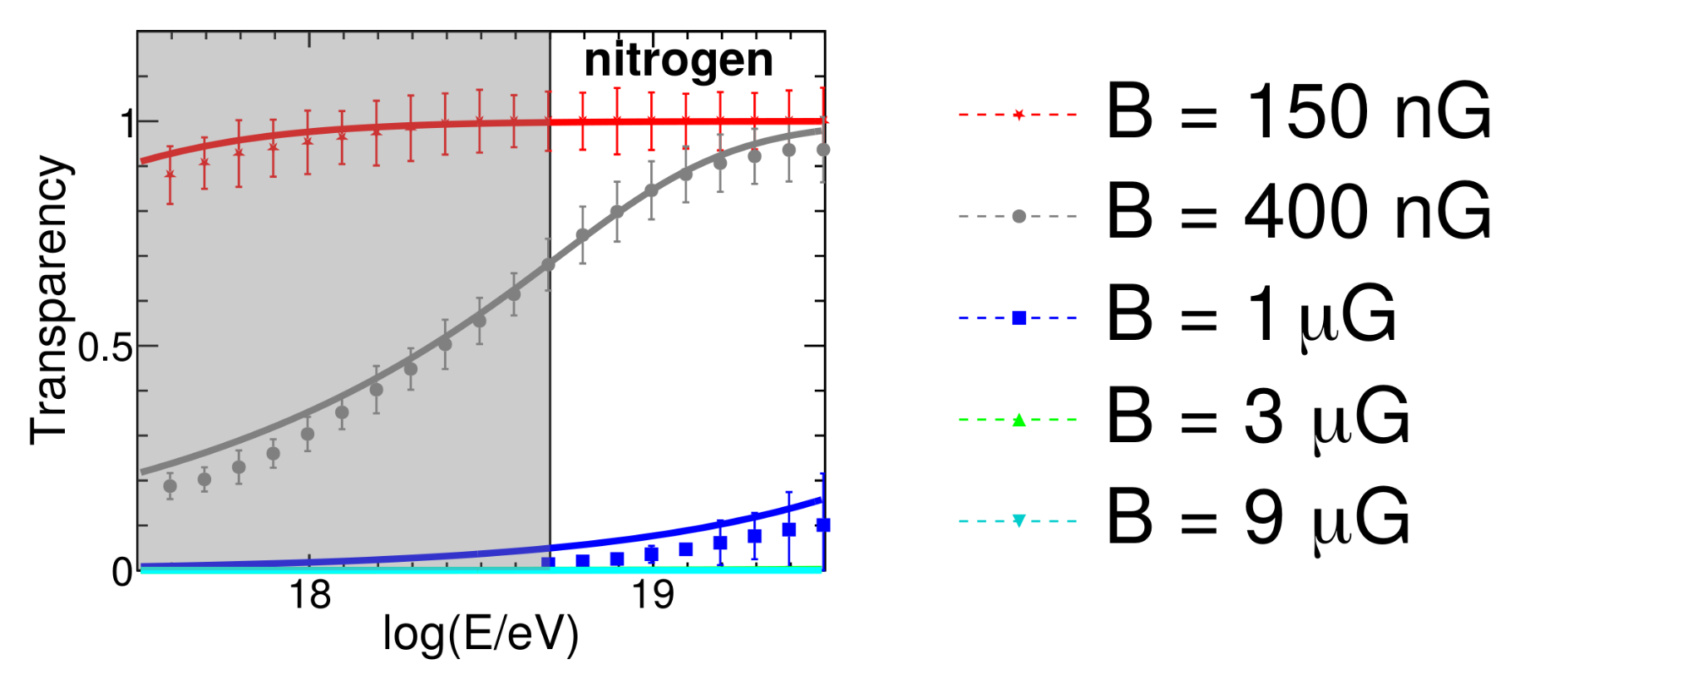
Magnetic fields
Condorelli, Biteau, Adam, ApJ 23
transparent
Galaxy clusters: B ~ 1-10 µG
Calorimeters for UHE nuclei (Dolag+ 09, Kotera+09, Harari+16, Fang & Murase 18, Condorelli+, ApJ ‘23)
Turn OFF bright X-ray clusters (Virgo, Perseus, Coma)
Galaxy filaments: B ~ 10-100 nG
Transparent to UHE nuclei (Condorelli+, ApJ ‘23)
No need for specific treatment
Voids: B < 10 pG
Too low to have a sizeable impact on UHECRs within GZK horizon
The Local Sheet: B ~ B_{filaments}?
Translucent, w/ angular spread θ_{obs, UHECR} ~ Δθ_{Local Sheet}
Time spread → d_{min} = extent of B_{Local Sheet} ~ few Mpc
opaque
The Milky Way (Jansson & Farrar ‘12)
Δτ_{MW} « Δτ_{Local Sheet}, Δθ_{MW} accounted for
Test of coherent deflections with 1 model

Slide 10
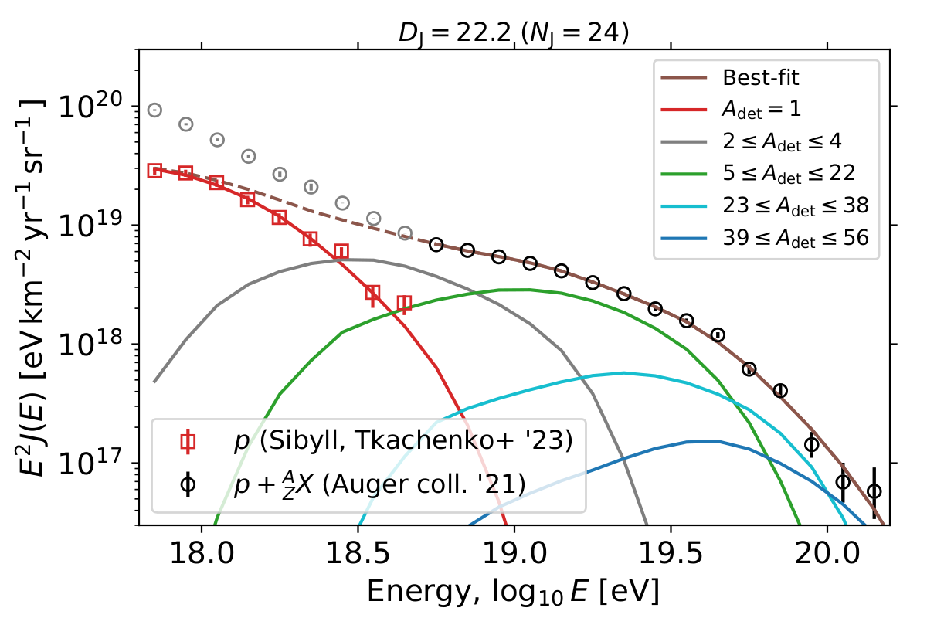
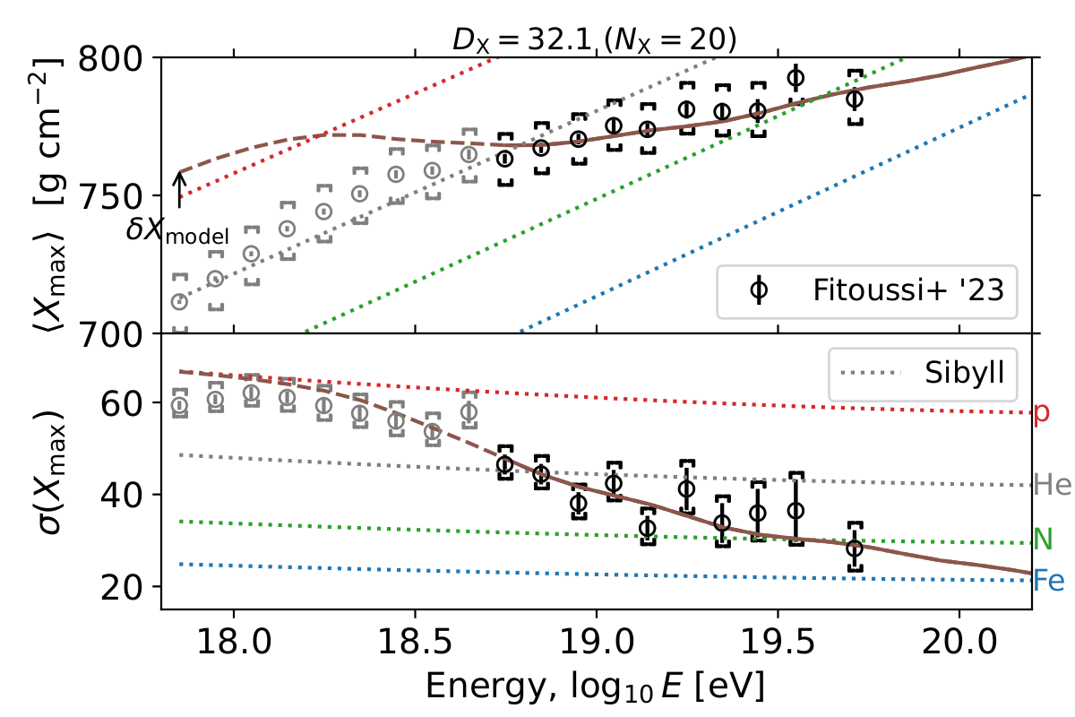
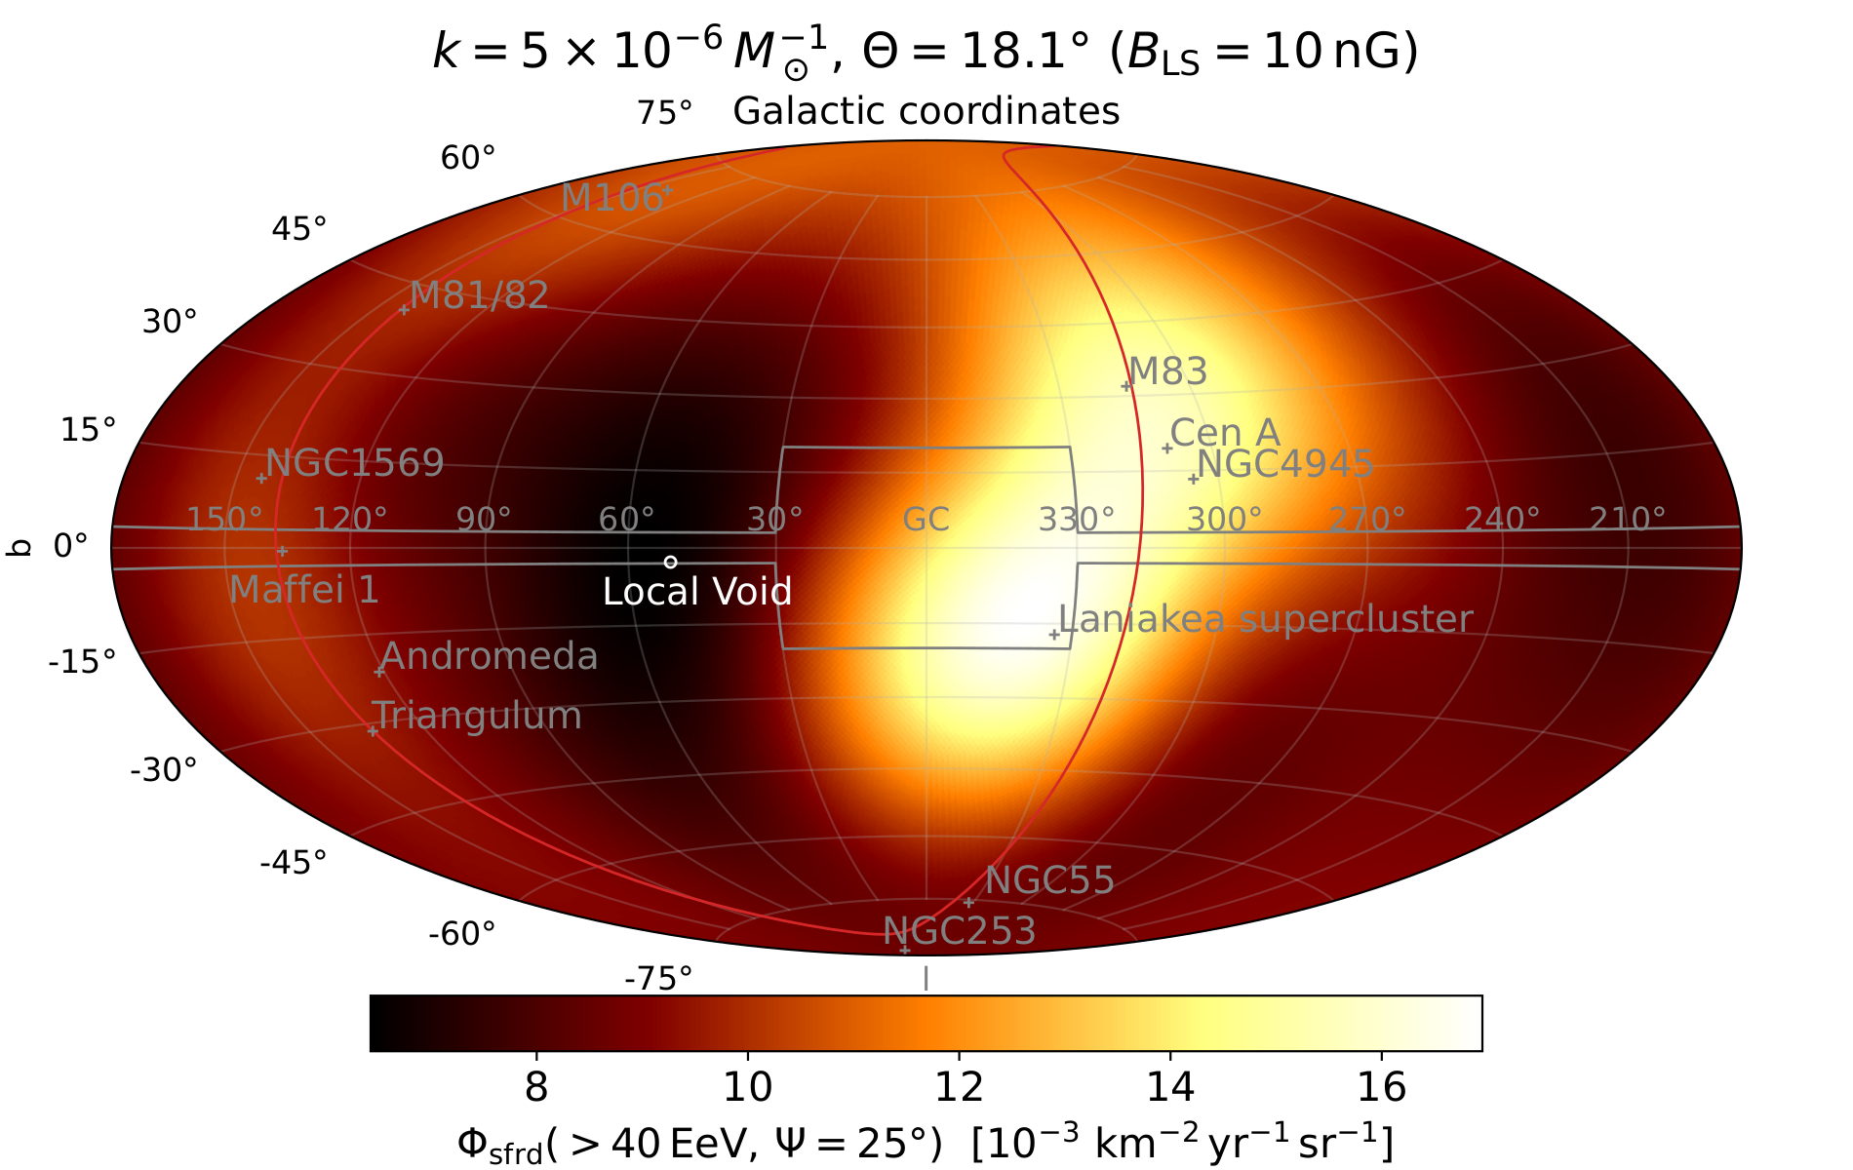
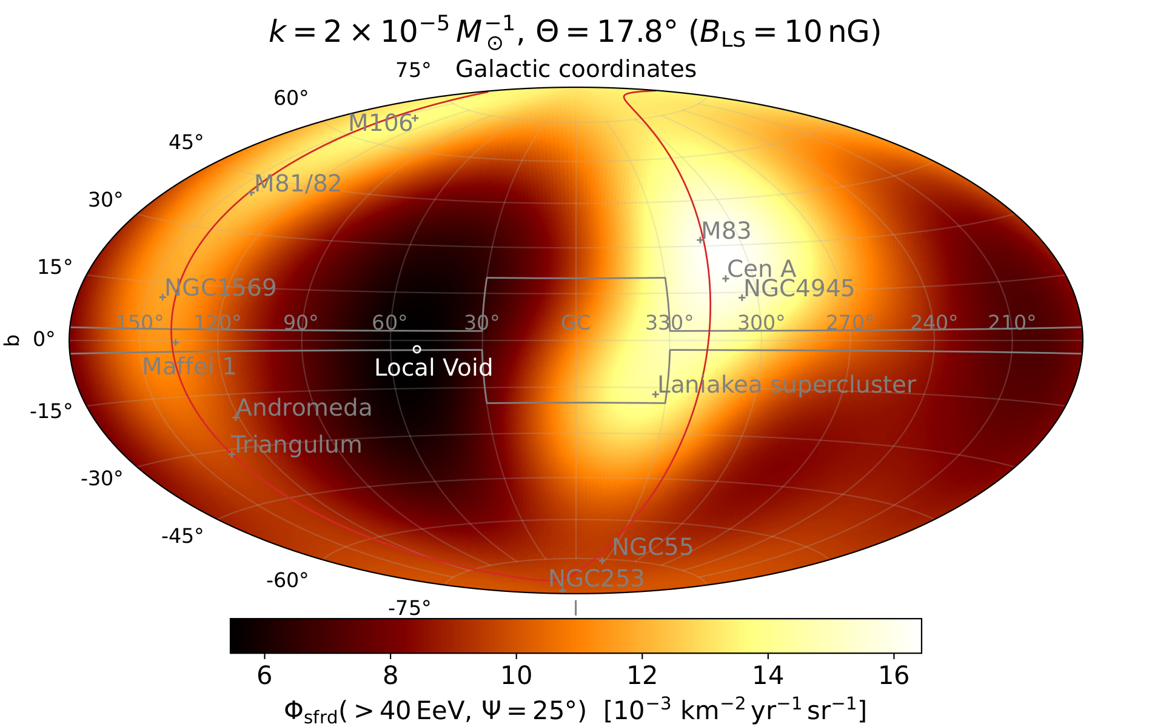
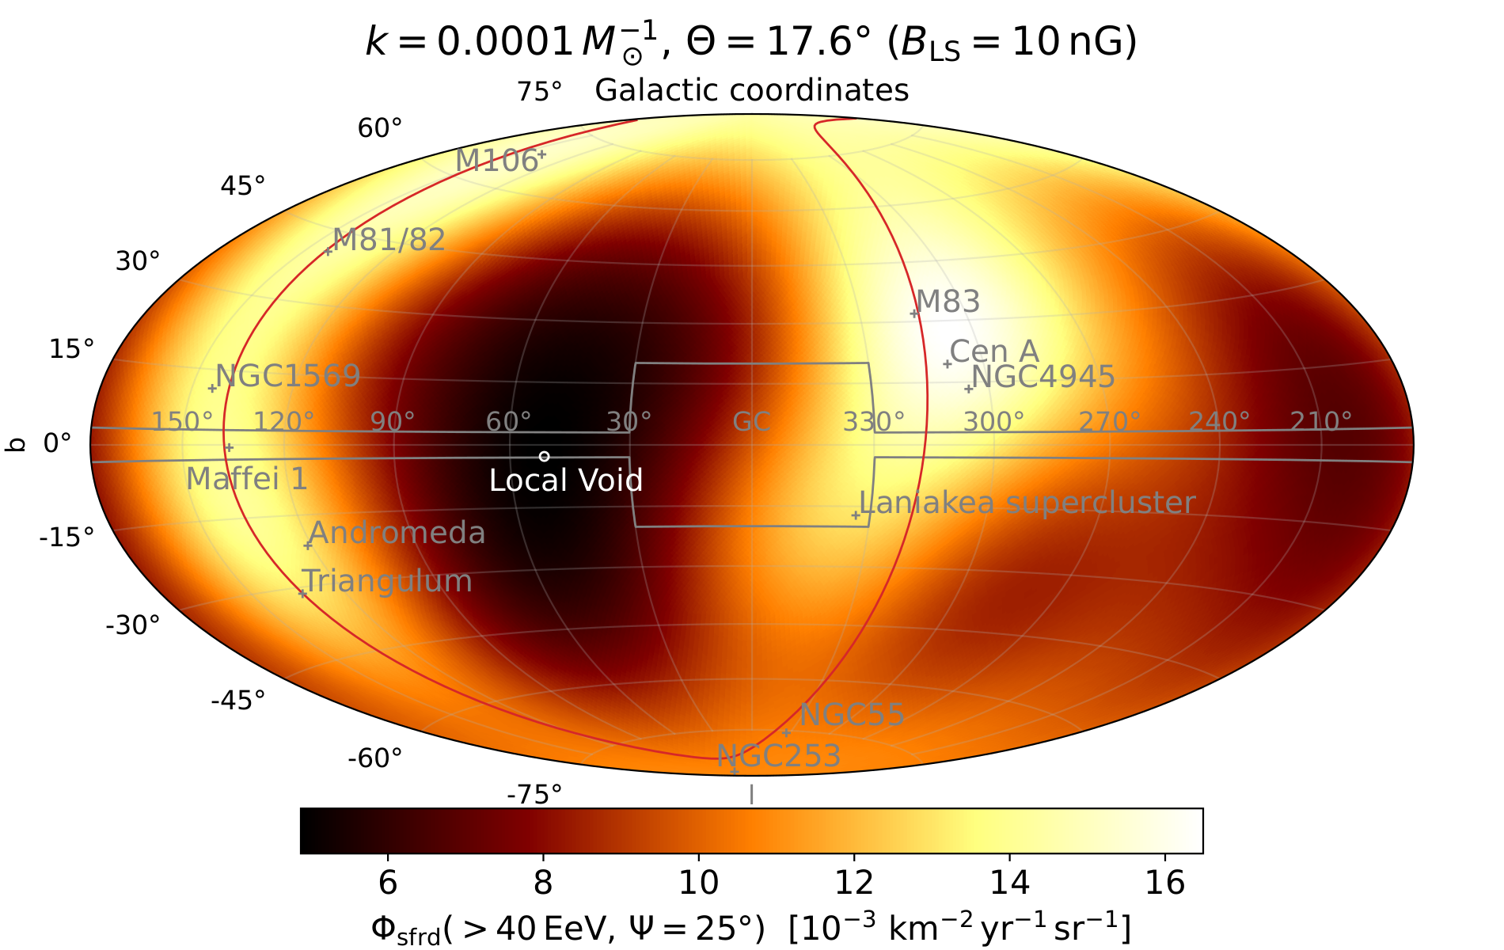
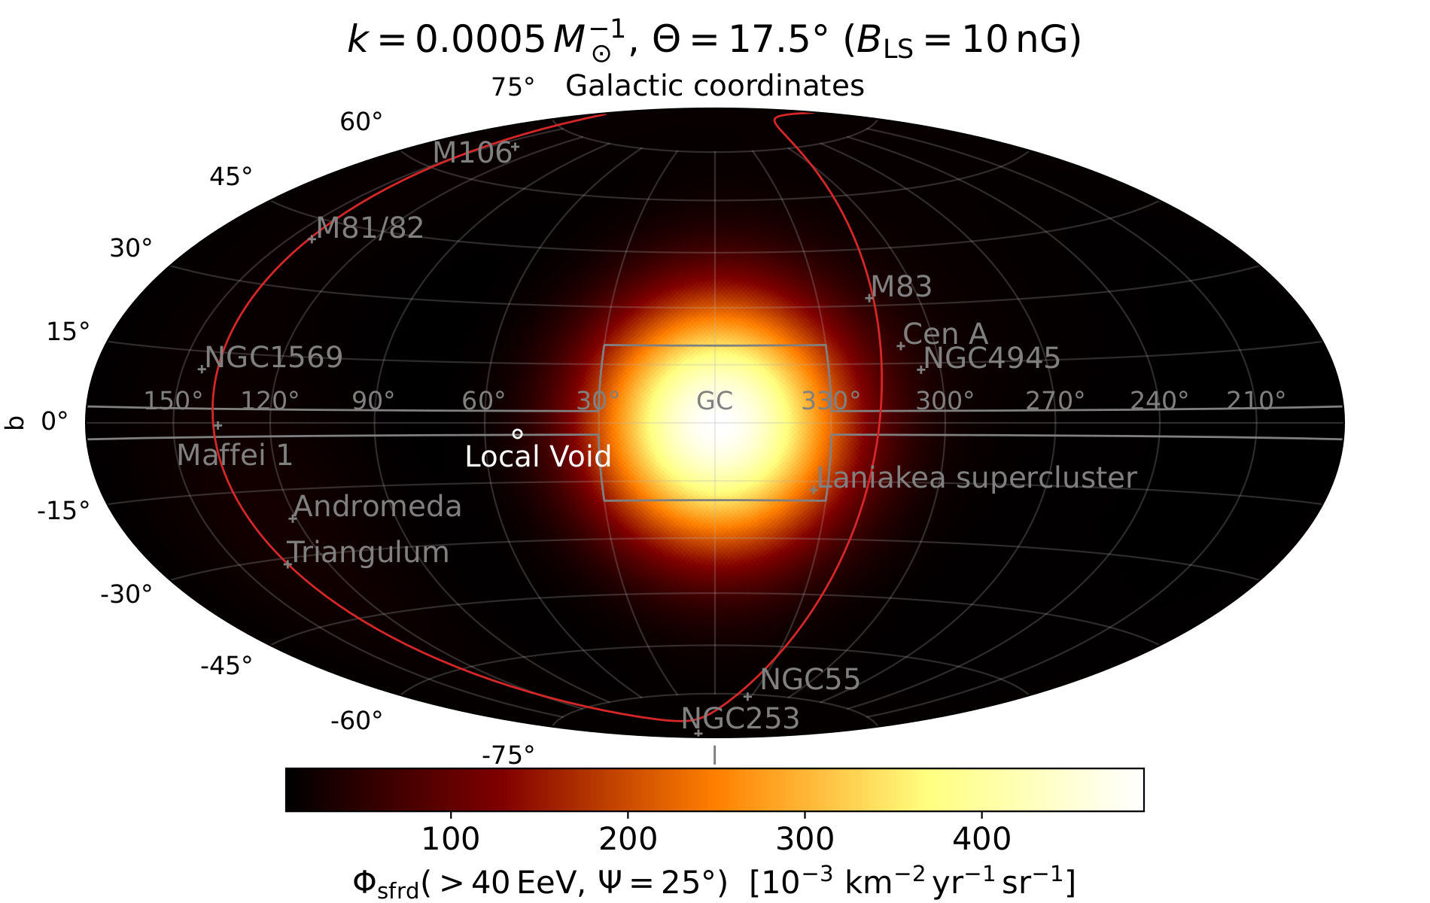
Transient model of UHECR sky
Spectral & composition model (see also Luce+ ApJ ‘22)
Increasing value of burst rate per star-formation unit k, for a given B-field in the Local Sheet

Slide 11
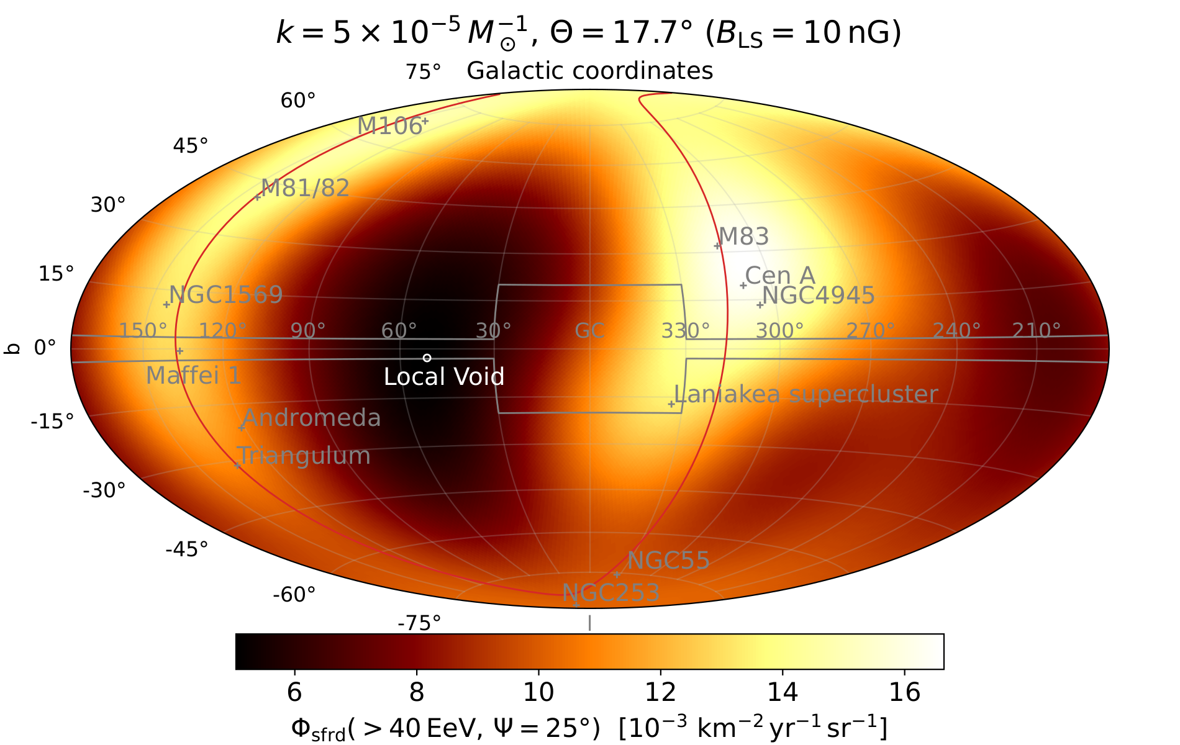
Closing the Net on UHECR Transient Sources
Auger + TA data
Credits: L. Caccianiga for Auger & TA
UHECR Model ≈ UHECR Data
Δθ(hotspot_{model}, hotspot_{data}) < 40°
Best-match transient scenario
Credits: Marafico, JB+ ‘24

Slide 12
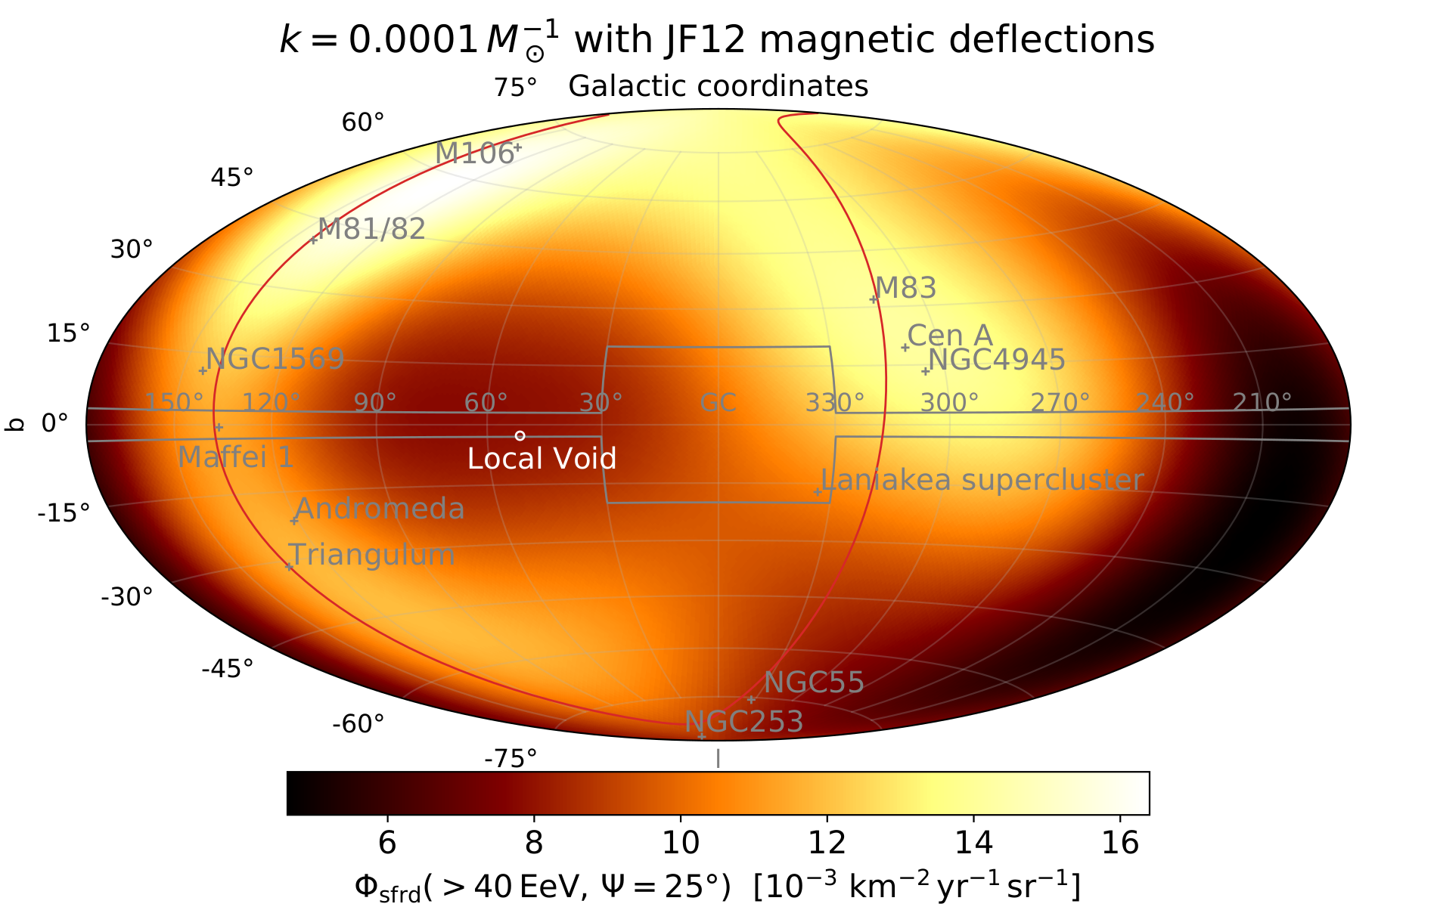
Closing the Net on UHECR Transient Sources
Auger + TA data
Credits: L. Caccianiga for Auger & TA
UHECR Model ≈ UHECR Data
Δθ(hotspot_{model}, hotspot_{data}) < 40°
Best-match transient scenario
Credits: Marafico, JB+ ‘24

Slide 13
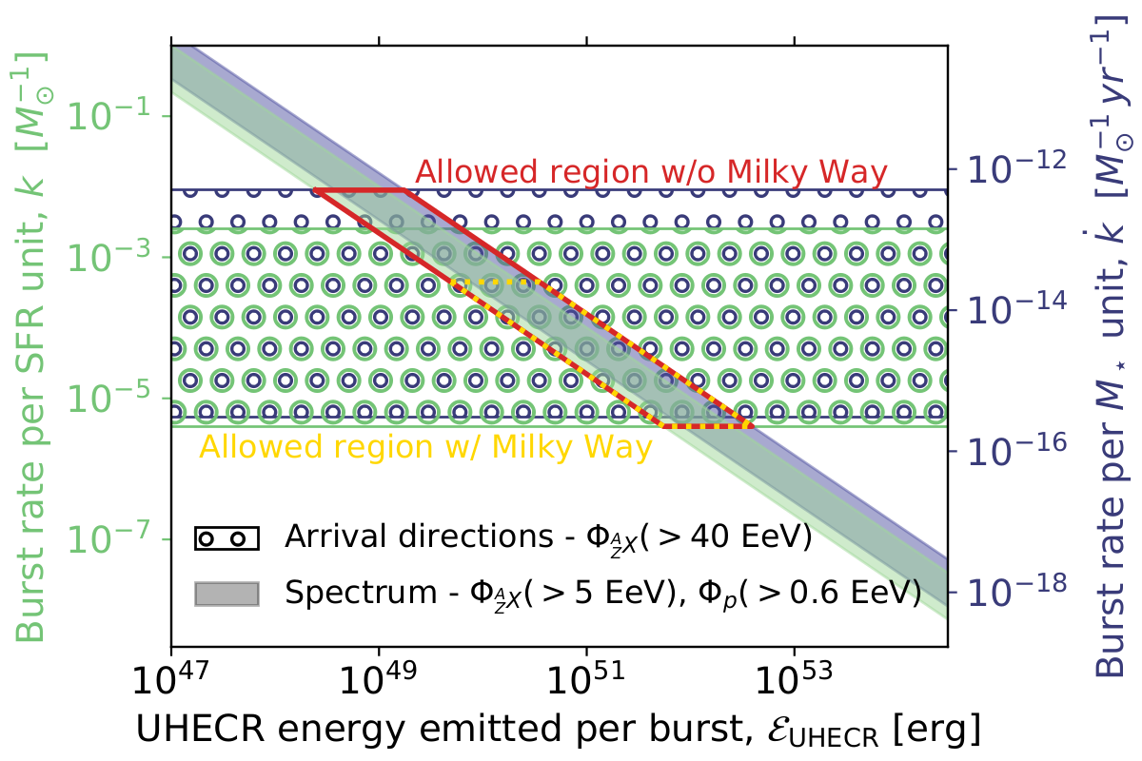
Closing the Net on UHECR Transient Sources
Solution with at least 1 Northern & Southern hotspot found for
Local Sheet B_{rms} = 0.5 - 20 nG
Auger + TA data
Credits: L. Caccianiga for Auger & TA
UHECR Model ≈ UHECR Data
Δθ(hotspot_{model}, hotspot_{data}) < 40°
Best-match transient scenario
Credits: Marafico, JB+ ‘24

Slide 14
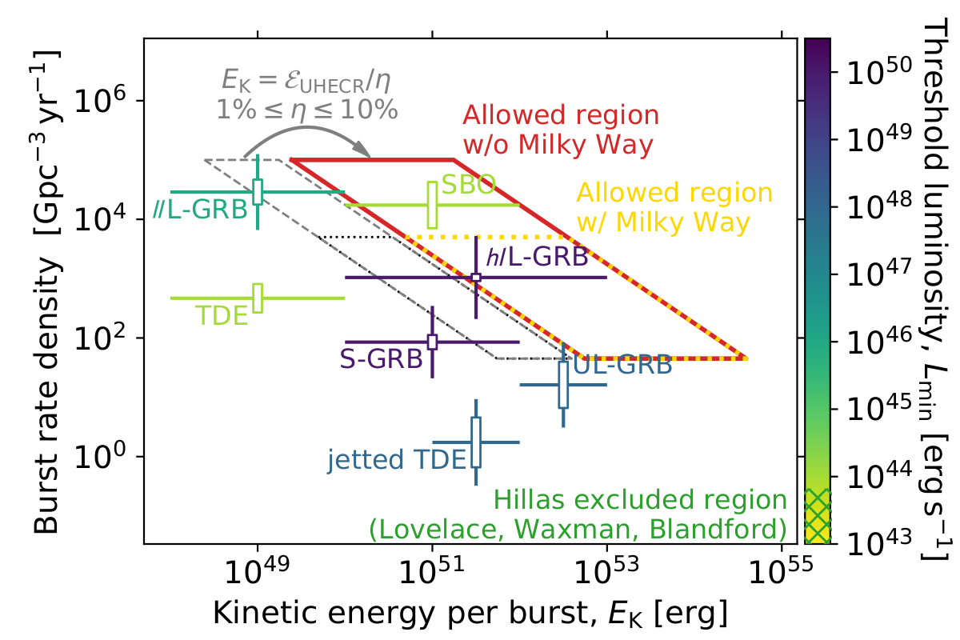
Closing the Net on UHECR Transient Sources
X-ray transient rate vs kinetic energy
Auger + TA data
Credits: L. Caccianiga for Auger & TA
UHECR Model ≈ UHECR Data
Δθ(hotspot_{model}, hotspot_{data}) < 40°
Best-match transient scenario
Credits: Marafico, JB+ ‘24

Slide 15
Conclusions
Marafico, Biteau, Condorelli, Deligny, Bregeon, ApJ 972, 1 2024
Local Sheet B_{rms} = 0.5 - 20 nG
Whether LOFAR could already probe such a field or whether SKAO could reveal it remains TBD
Transient rate = 50 - 30,000 Gpc⁻³ yr⁻¹
The only stellar-sized transients that satisfy both Hillas’ and our criteria are long gamma-ray bursts

Slide 16
Backup

Slide 17
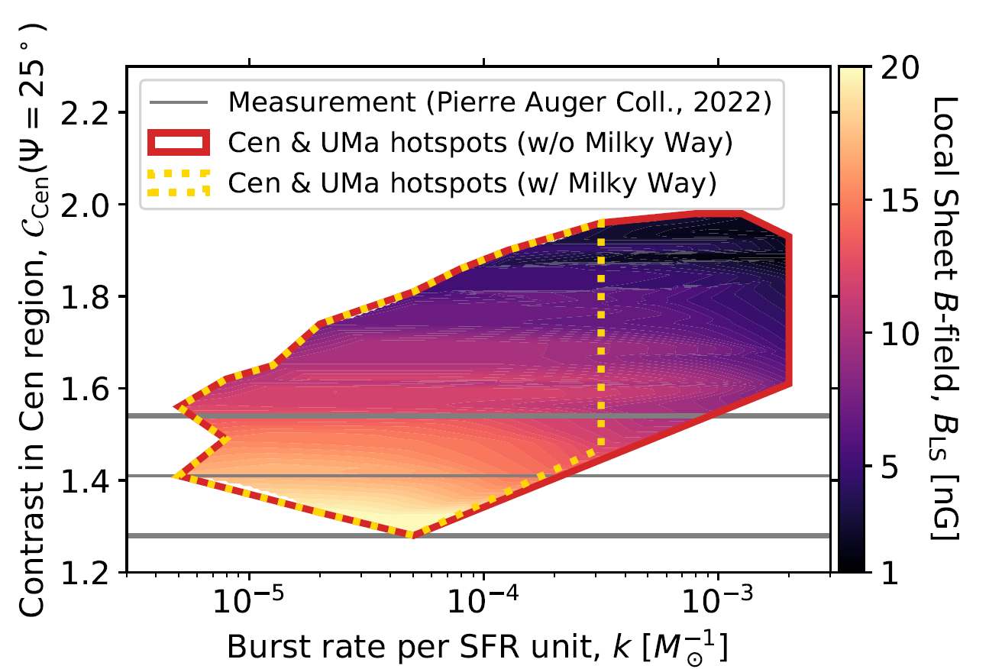
Contrast in the Centaurus region
Marafico, Biteau, Condorelli, Deligny, Bregeon, ApJ 972, 1 2024
Auger + TA data
Credits: L. Caccianiga for Auger & TA
Best-match transient scenario
Credits: Marafico, JB+ ‘24

Slide 18
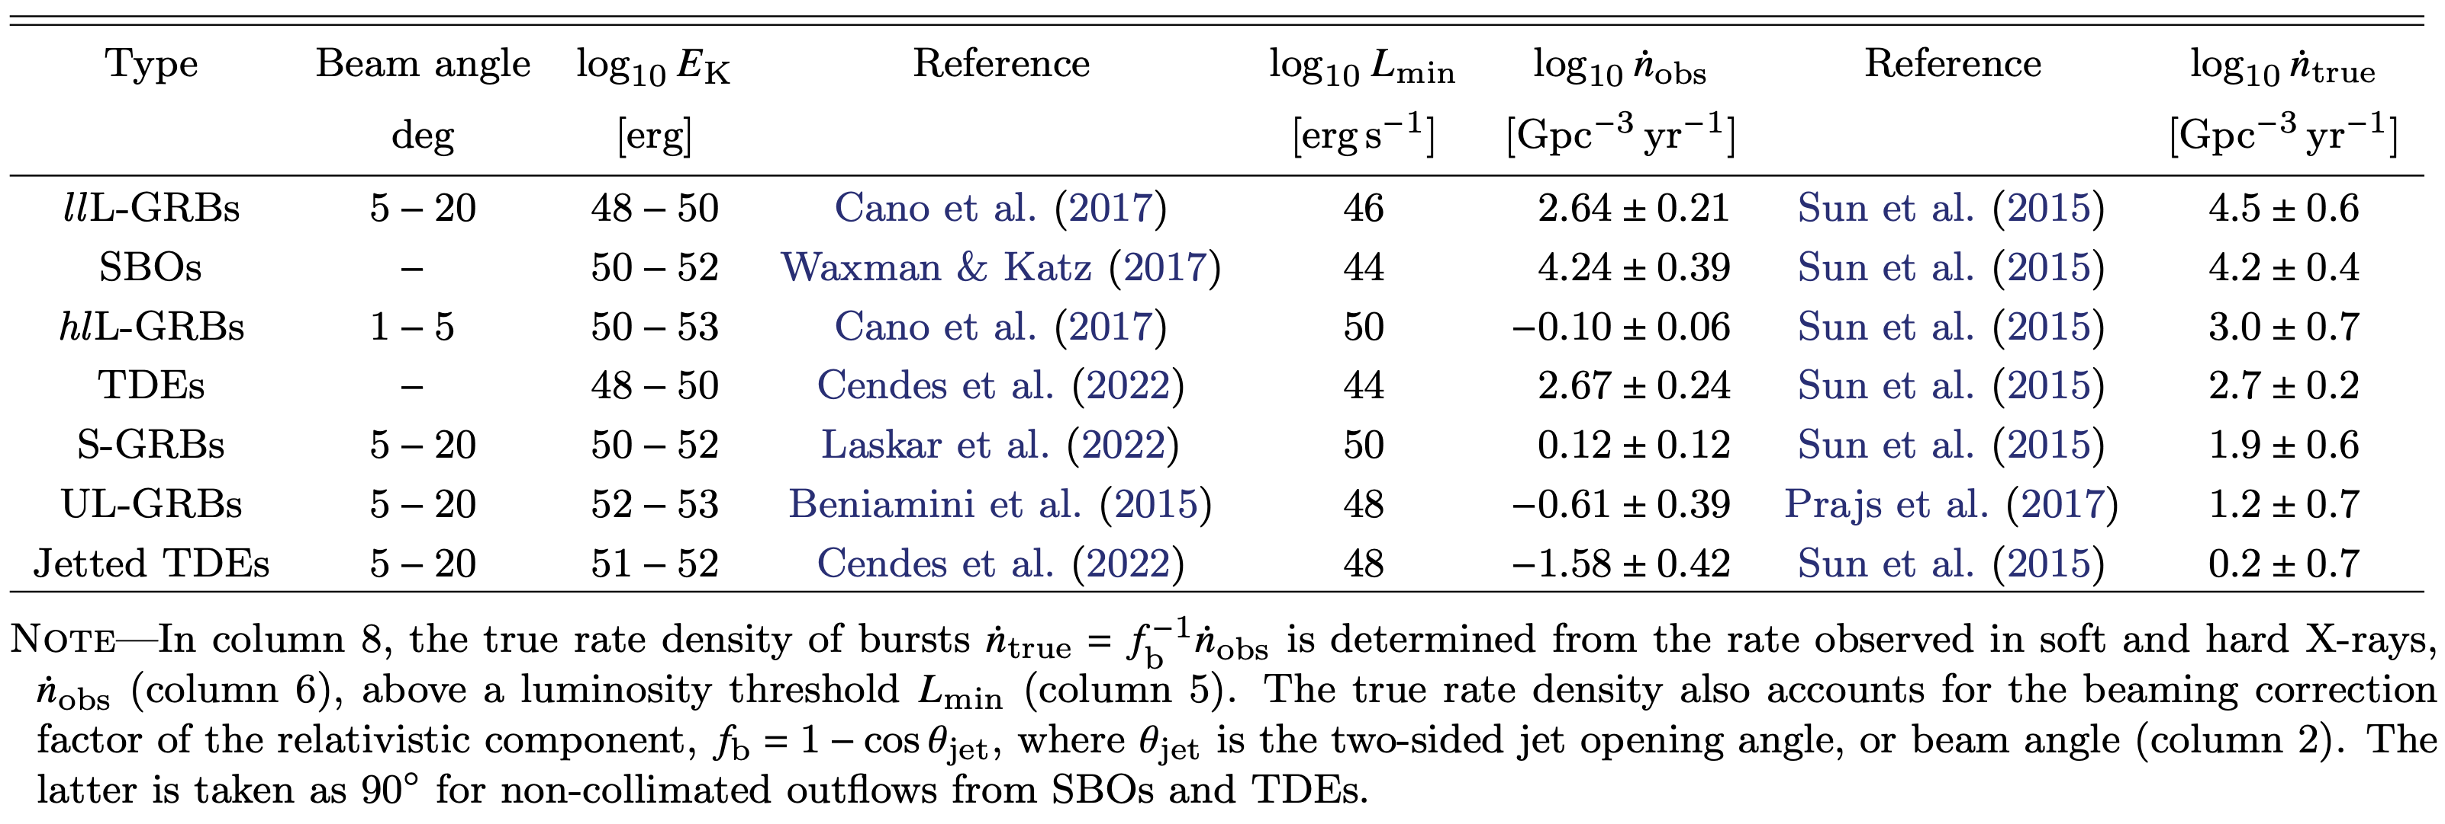
Properties of the stellar-sized X-ray transients

Slide 19
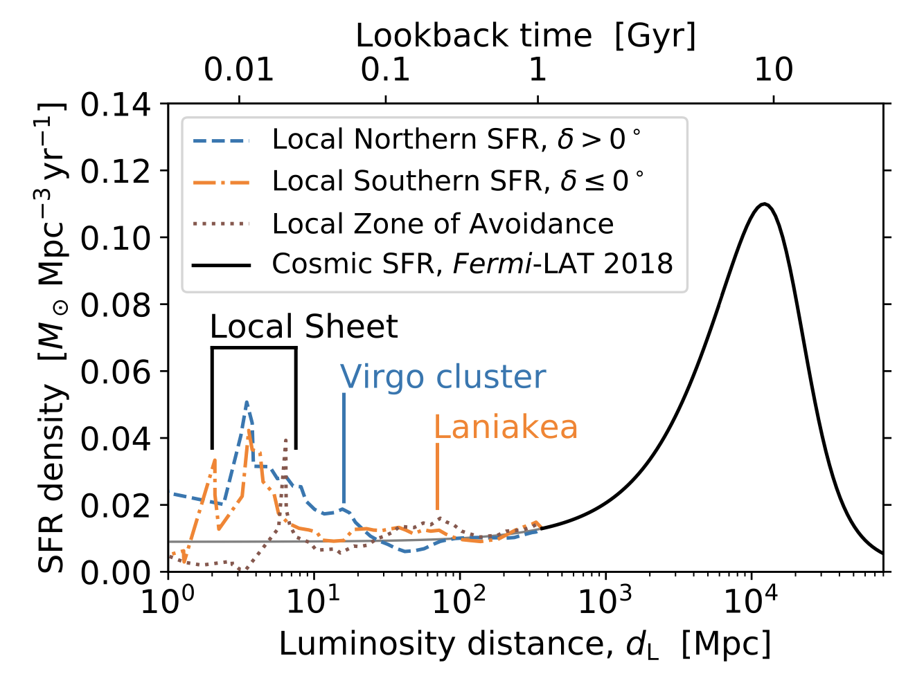
A cosmographic view on stellar mass and star formation
410,761 galaxies out to 350 Mpc, distance at which 50% of 𝑀∗ is below the 2MASS sensitivity limit
Distances checked against those tabulated in the HyperLEDA database (cosmic-ladder estimates for about 4,000 nearby galaxies that are not in the Hubble flow, spectroscopic estimates for about half of the sample and 2MPZ photometric estimates for the other half)
Galaxy-count decrease in the ZoA modeled with an empirical function of Galactic latitude, which provides incompleteness correction factors
Galaxy cloning close to the Galactic bulge, by filling of the ZoA with galaxies from mirrored regions above and below the Galactic plane
Parameterization of the deep-field M* function used to infer incompleteness correction factors vs luminosity distance
SFR estimates by exploiting the relation between M* and SFR for three morphological branches established with NIR and Halpha observations of galaxies in the Local Volume at distances smaller than 11 Mpc
Morphological information available from HyperLEDA for about a third of the sample out to 350 Mpc; observed morphological distribution as a function of distance exploited to provide a statistical estimate of SFR for the remaining two thirds of the sample
Correction factors for the SFR density

Slide 20
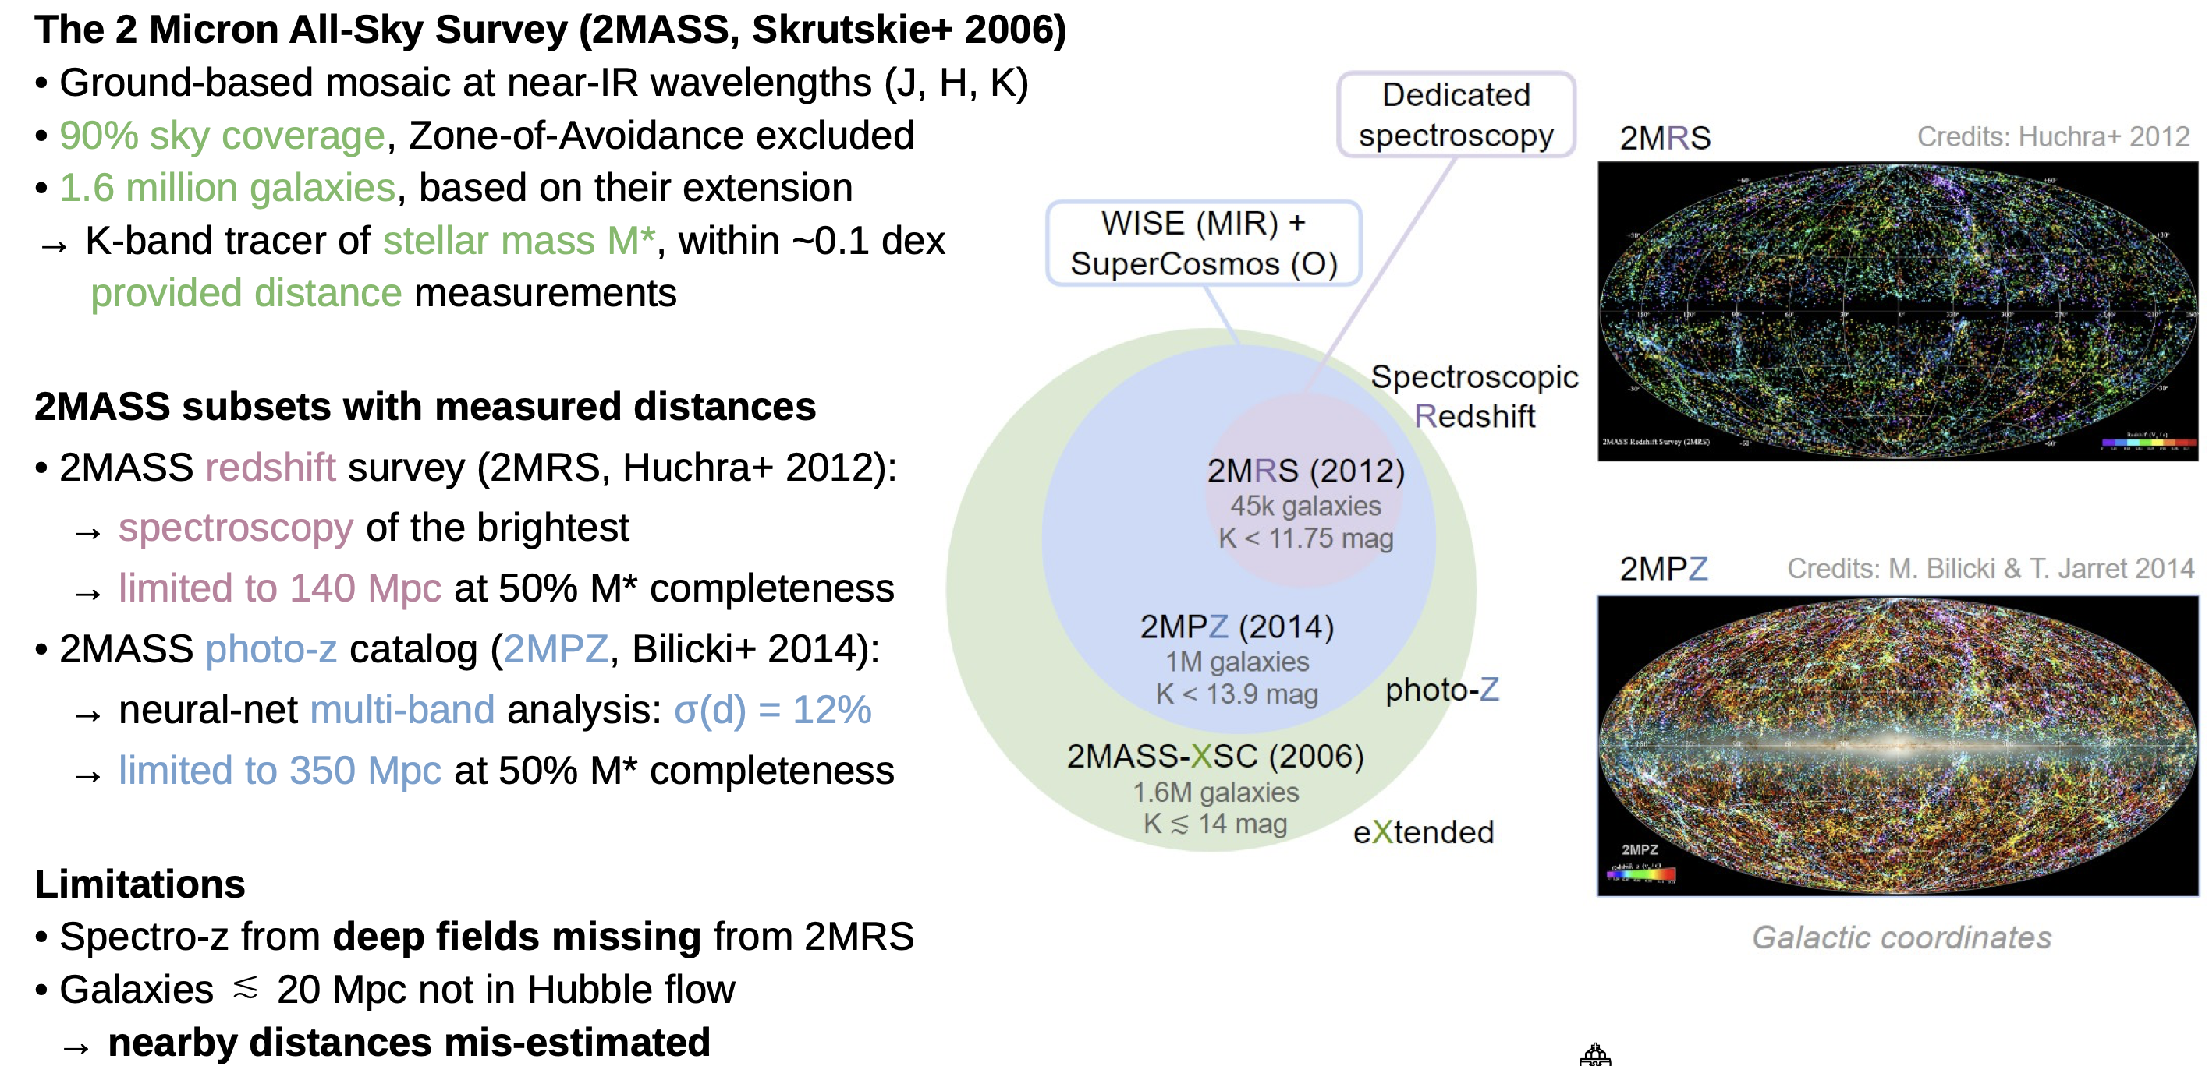
Stellar mass cosmographies

Slide 21
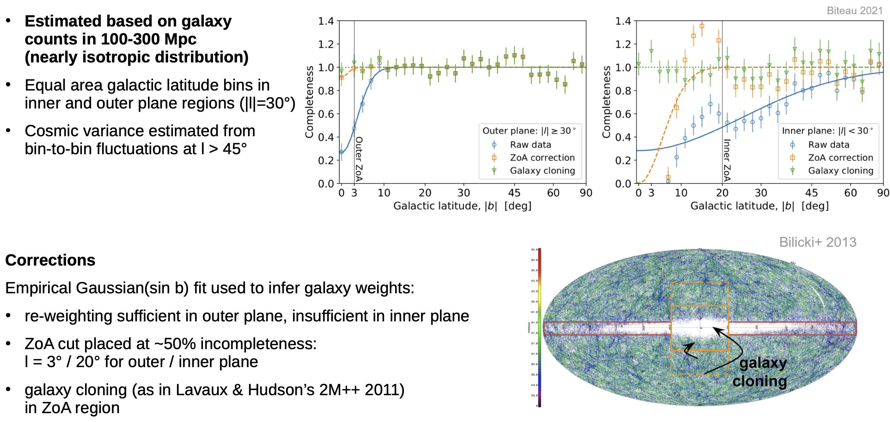
Incompleteness in the Zone of Avoidance

Slide 22
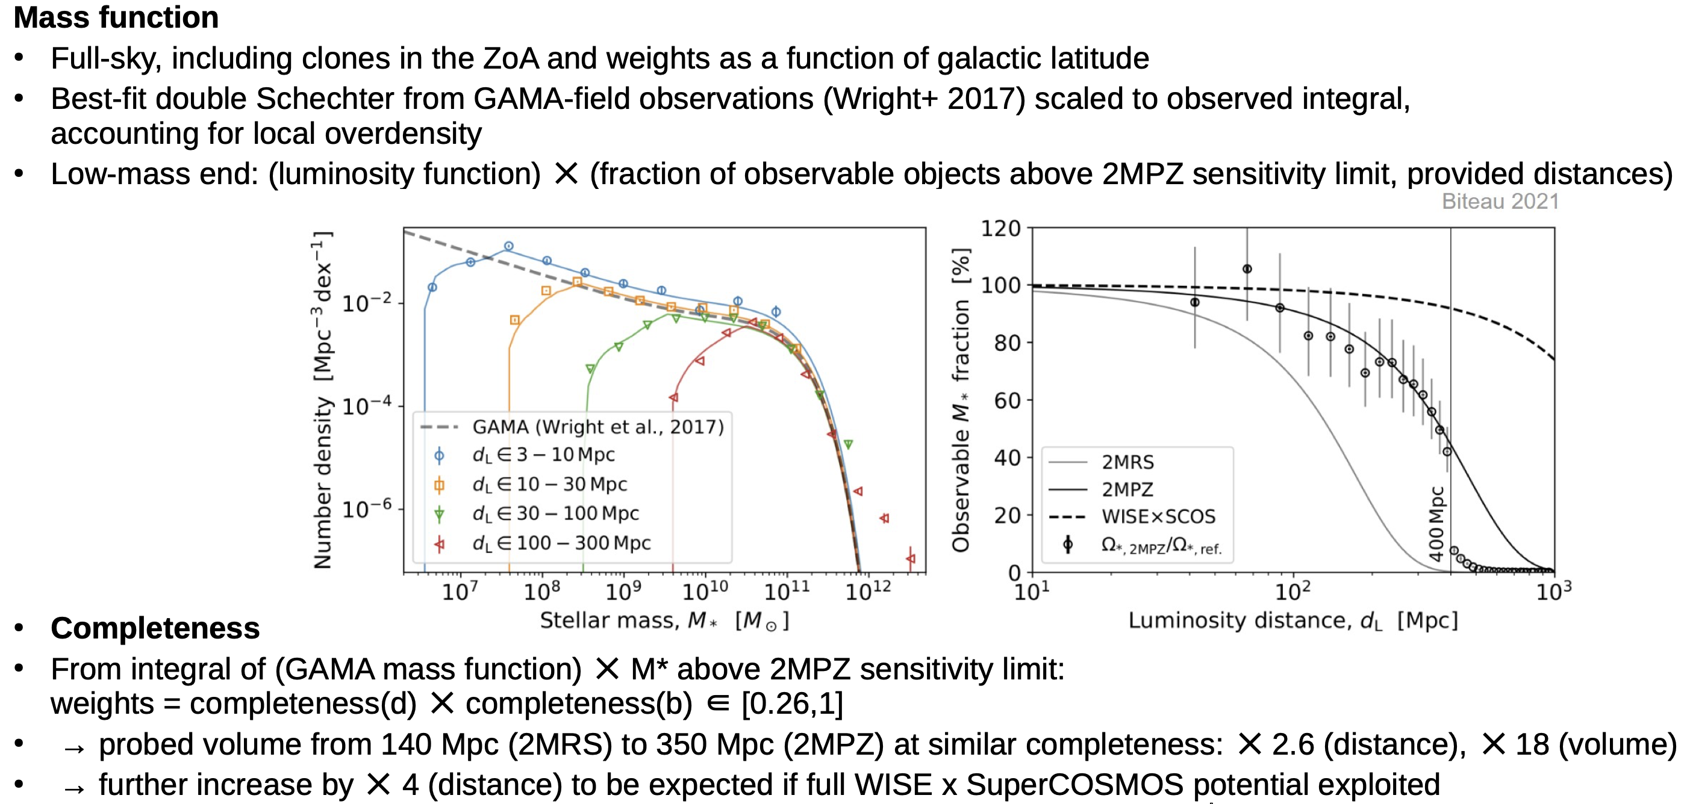
Incompleteness with increasing distance

Slide 23
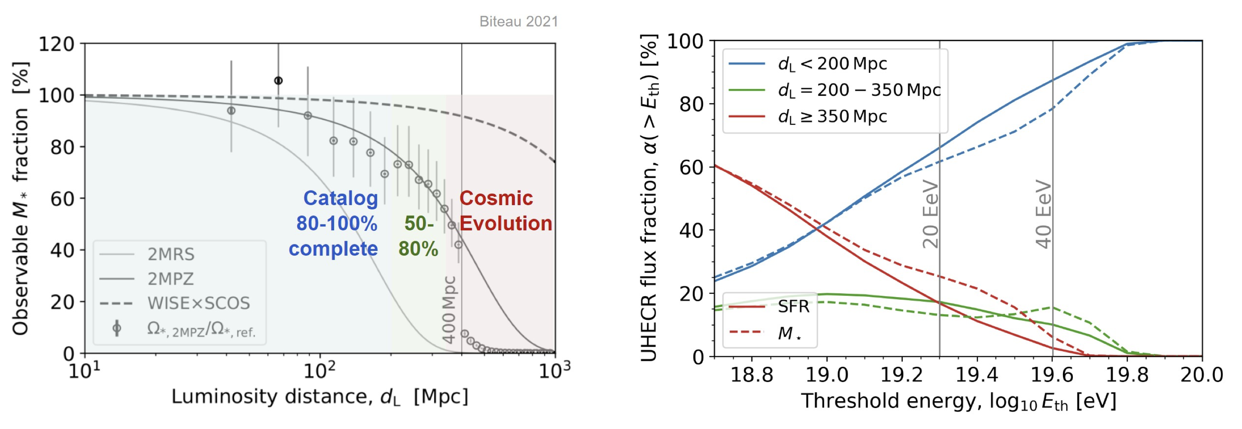
Fraction of UHECR signal from successive shells

Slide 24
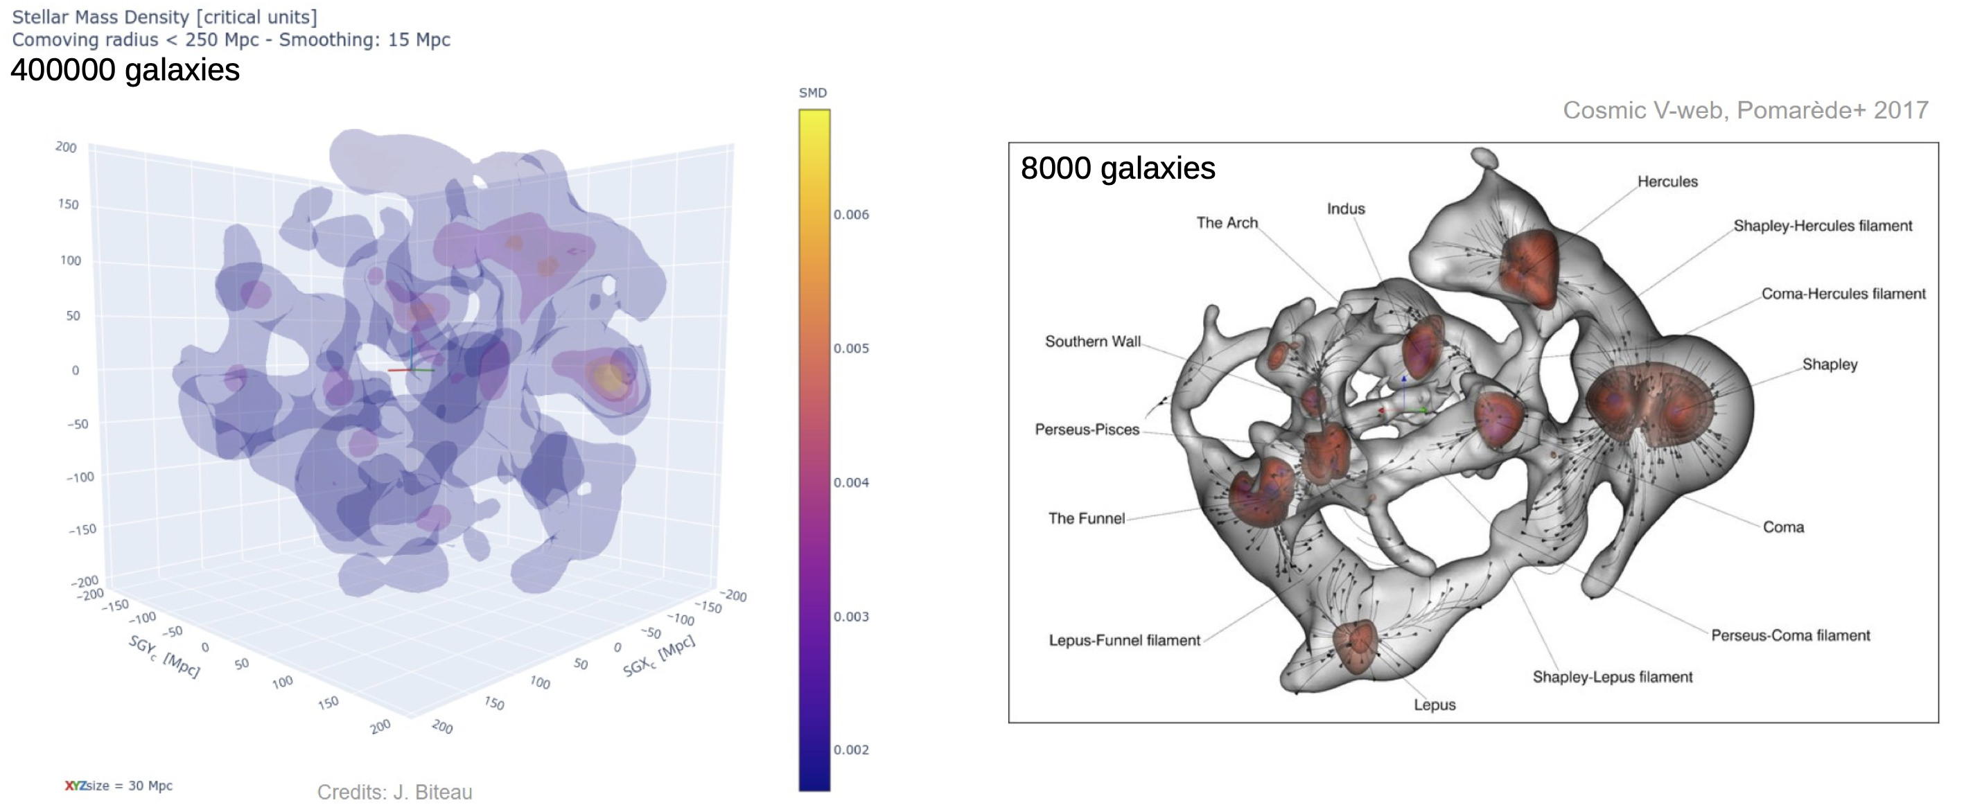
Comparison: cosmographies (limited here to Cosmic V-web volume)

