Slide 1



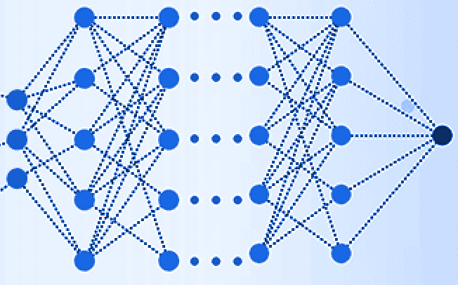
Evaluation of TA SD's energy reconstruction performance using a DNN and hybrid data
Anton Prosekin¹, Kozo Fujisue¹,
Anatoli Fedynitch^{1,2}, and Hiroyuki Sagawa²
for the Telescope Array Collaboration
¹Institute of Physics, Academia Sinica,
²Institute for Cosmic Ray Research
UHECR 2024, 17-21 November 2024

Slide 2
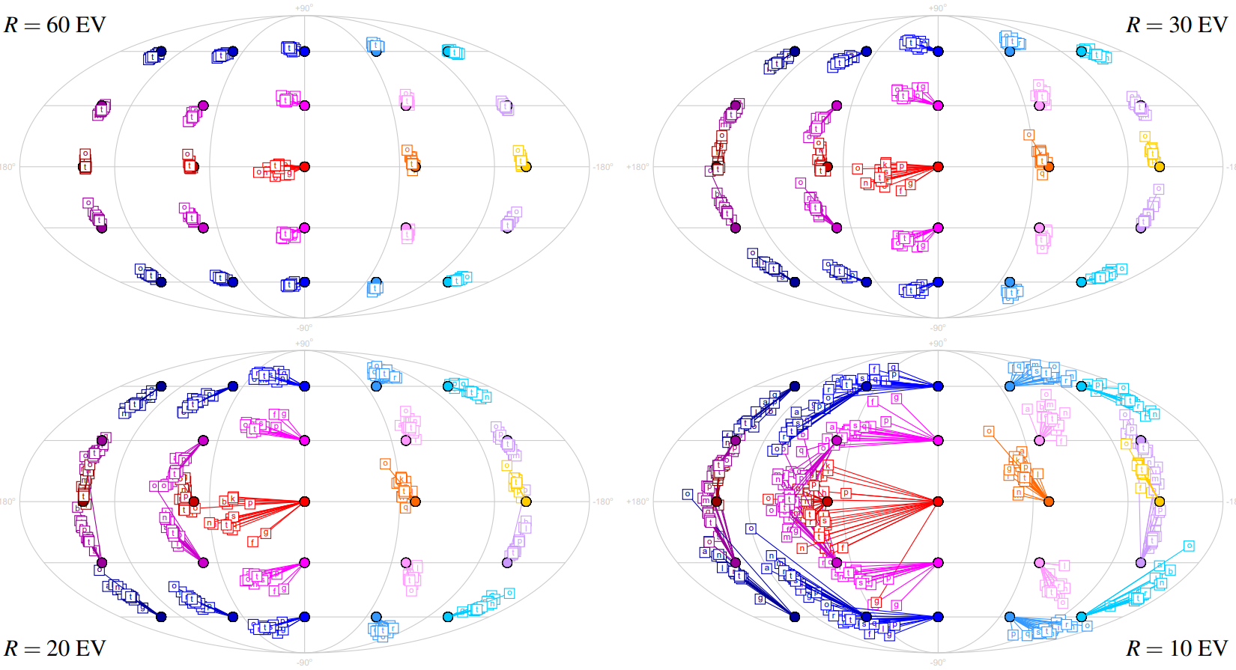
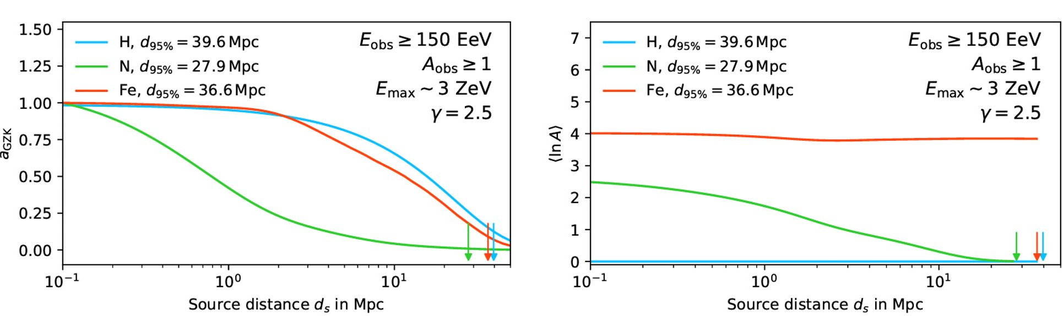
Motivation: Mass on event-by-event basis
Propagation:
Magnetic fields deflects UHECR in dependence of rigidity R ~ E/Z ( typically Z = 1 - 26)
Type of the particle determines the maximal distance (horizon) to the potential source
Large impact of Galactic magnetic fields:
For example particle E=60 EeV and Z=?:
arrived from outside galaxy points to
Z=1
Z=2
Z=3
Z=6
N. Globus, A. Fedynitch, R. Blandford, 2022
M.Unger, G. Farrar, ICRC2017
Backtracking of particles for different models of the coherent GMF
Source properties:
Acceleration at the source: maximum rigidity is determined by acceleration
Mass composition at the source

Slide 3
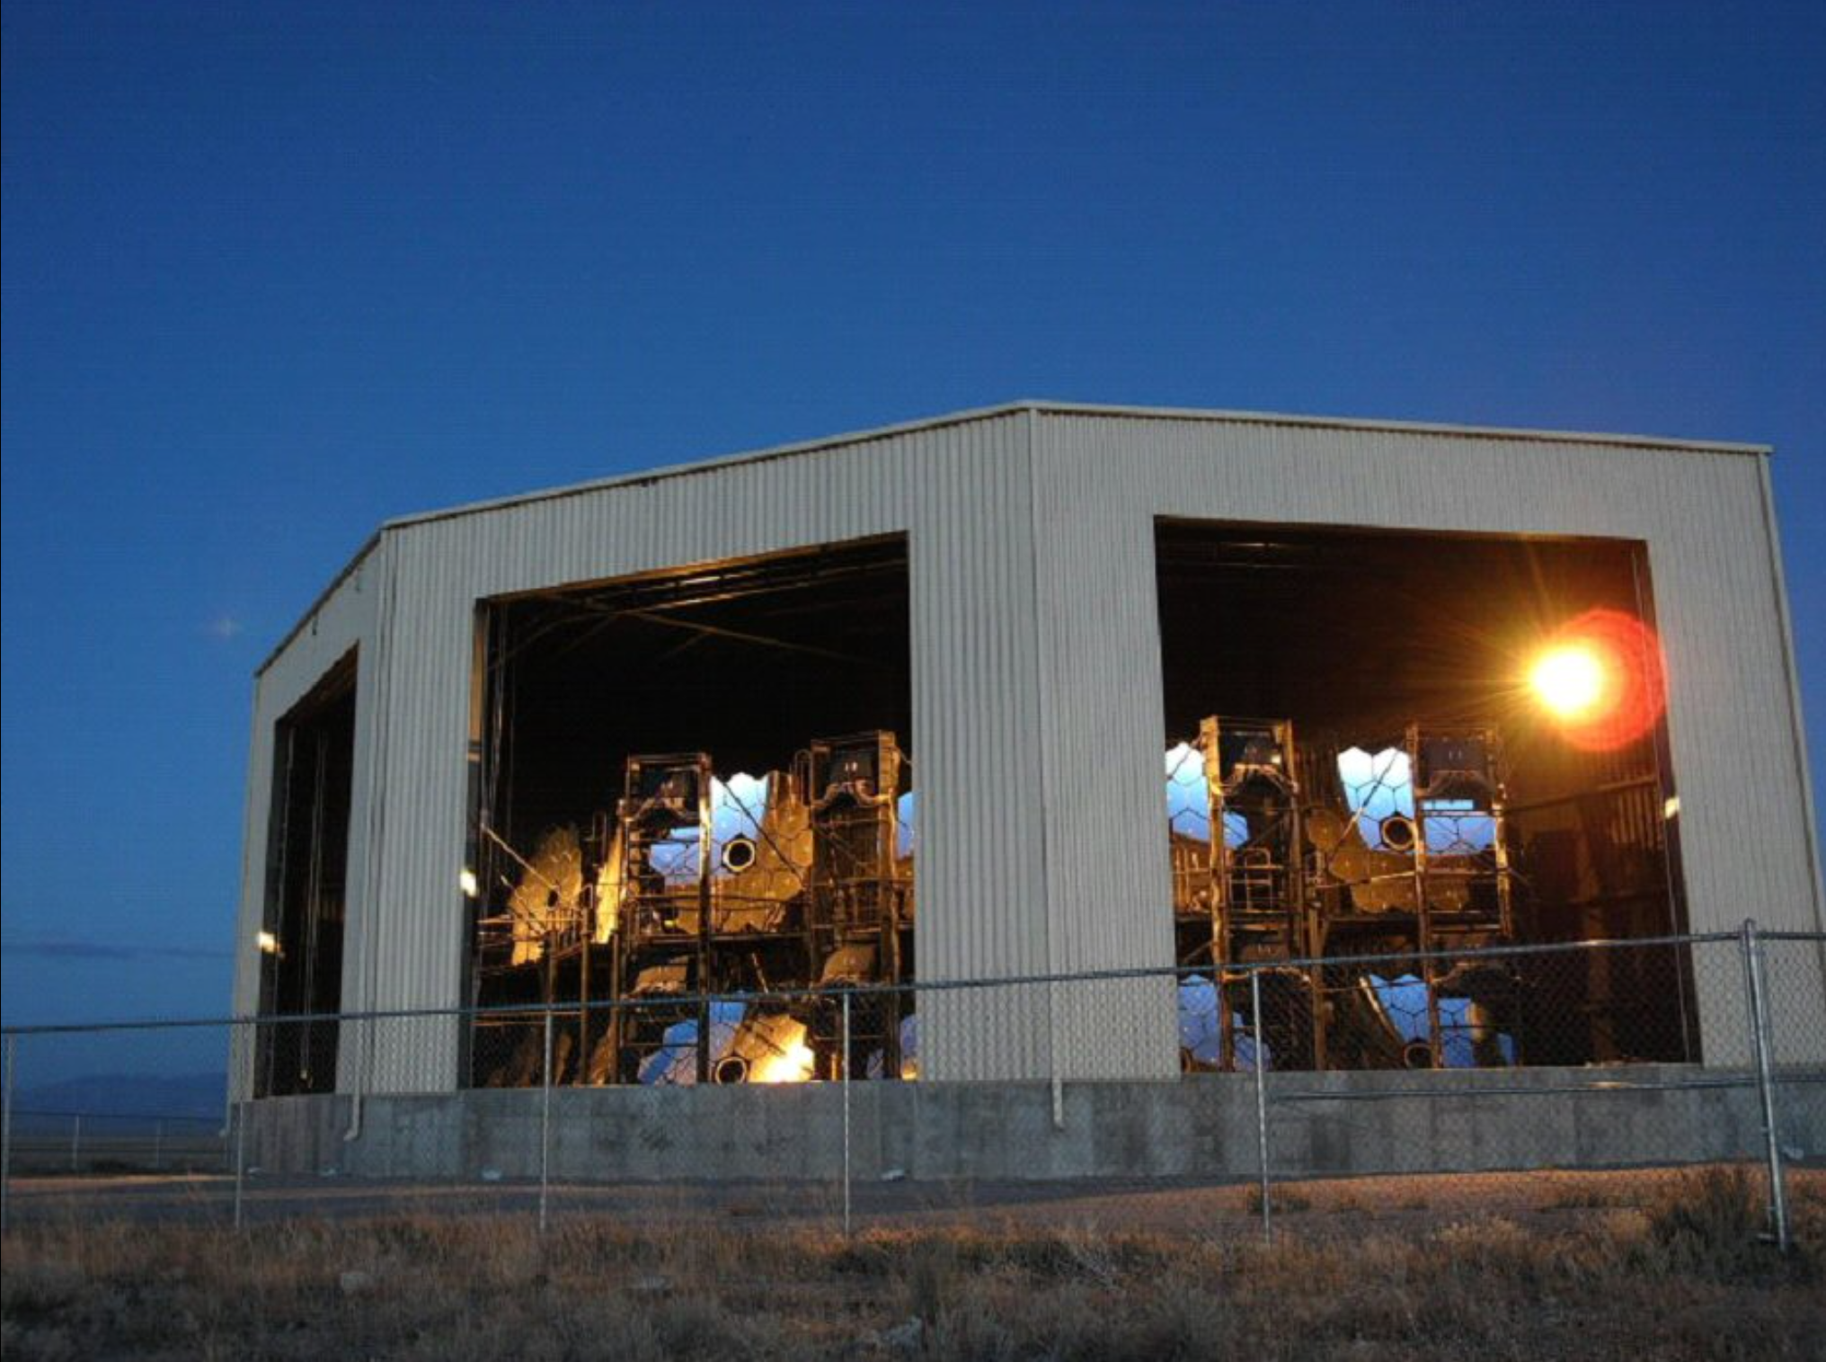
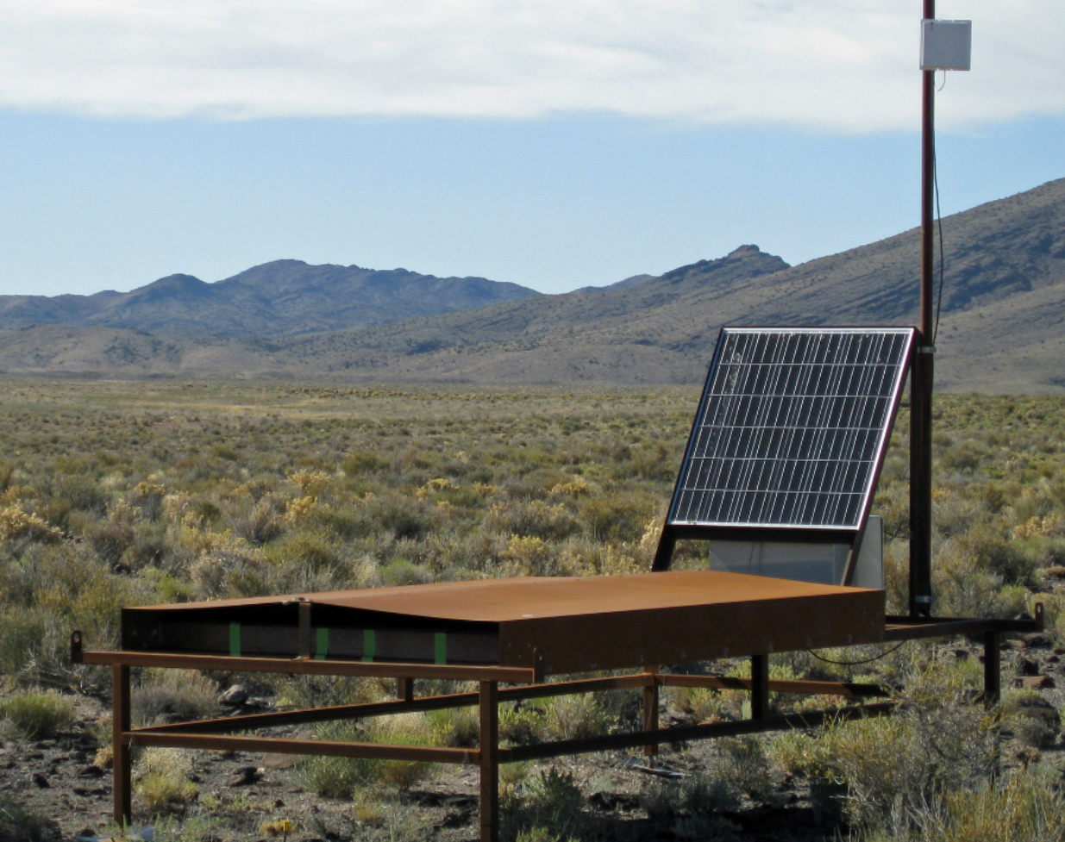
Mass reconstruction
Fluorescence Detector (FD):
  Directly observe X_{max} as an estimator for mass composition
  Limited statistics with duty cycle 10%
Surface Detector (SD):
  Large statistics with duty cycle 100%
  Can be used to extract primary mass via a number composition-related observables
  Extraction requires complicated analysis techniques with feature engineering
  DNN can automatically extract the most relevant features from the raw SD data
Fluorescence Detector
Surface Detector

Slide 4
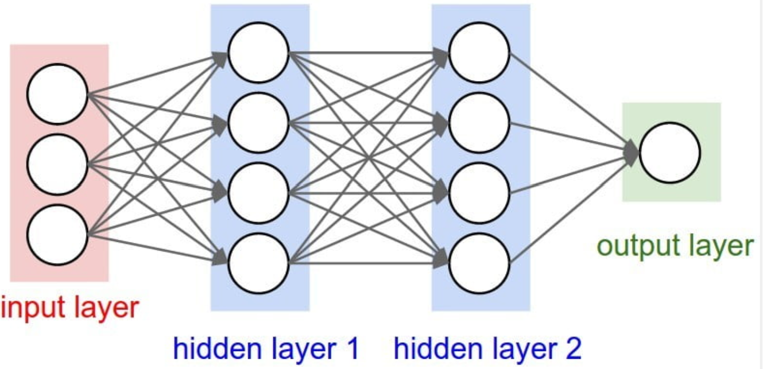
DNN approach
Deep Neural Network (DNN) vs. Standard reconstruction:
Learns complex non-linear patterns vs. physics-based constructed features
More robust to various uncertainties and shower-to-shower fluctuations
Generalize well to new events, allowing for reliable estimation on an event-by-event basis
Can use all shower data (time traces) vs. integral features (arrival times, total signal)
  can extract complex features (X_{max}, R_{μ}, A) ⟸ final objective
  more accurate reconstruction ⇒ boosting statistics with relaxed quality cuts ⟸ this talk
Simple DNN representation

Slide 5
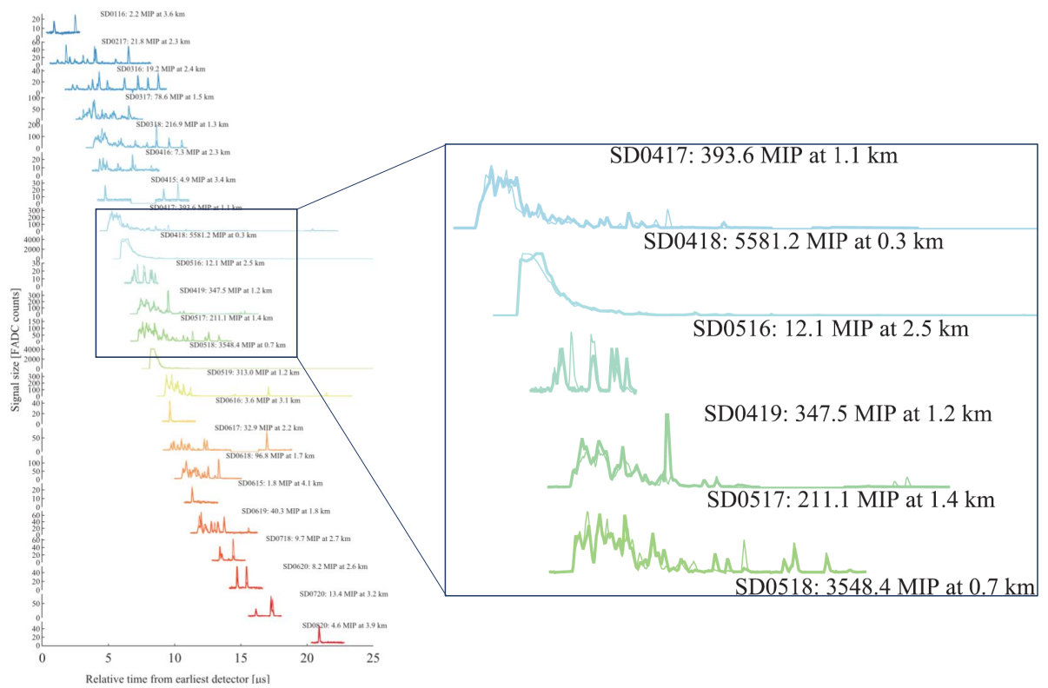
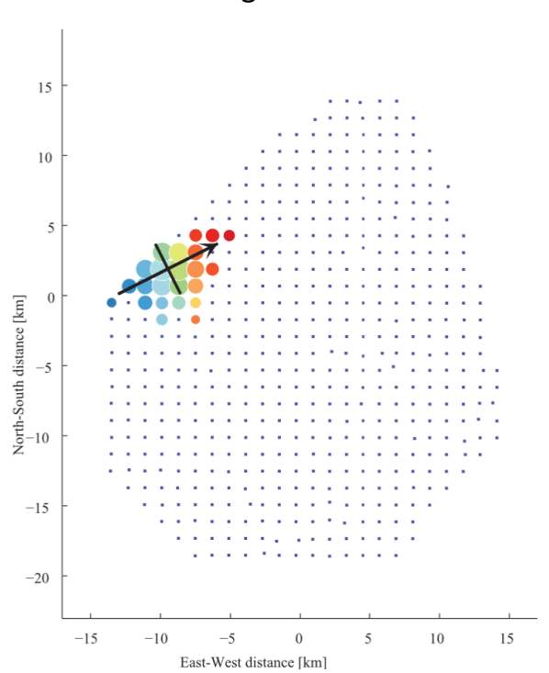
Time traces of surface detectors
Standard reconstruction uses:
1. geometry
2. arrival times
3. total signal
Time traces: 1-4 segments of 128-bin time series of 20 ns x 2 channels (upper/lower)
arrival times
Time traces and surface detector footprint for highest registered event of TA E=244 EeV (Science 382, 903 (2023))

Slide 6
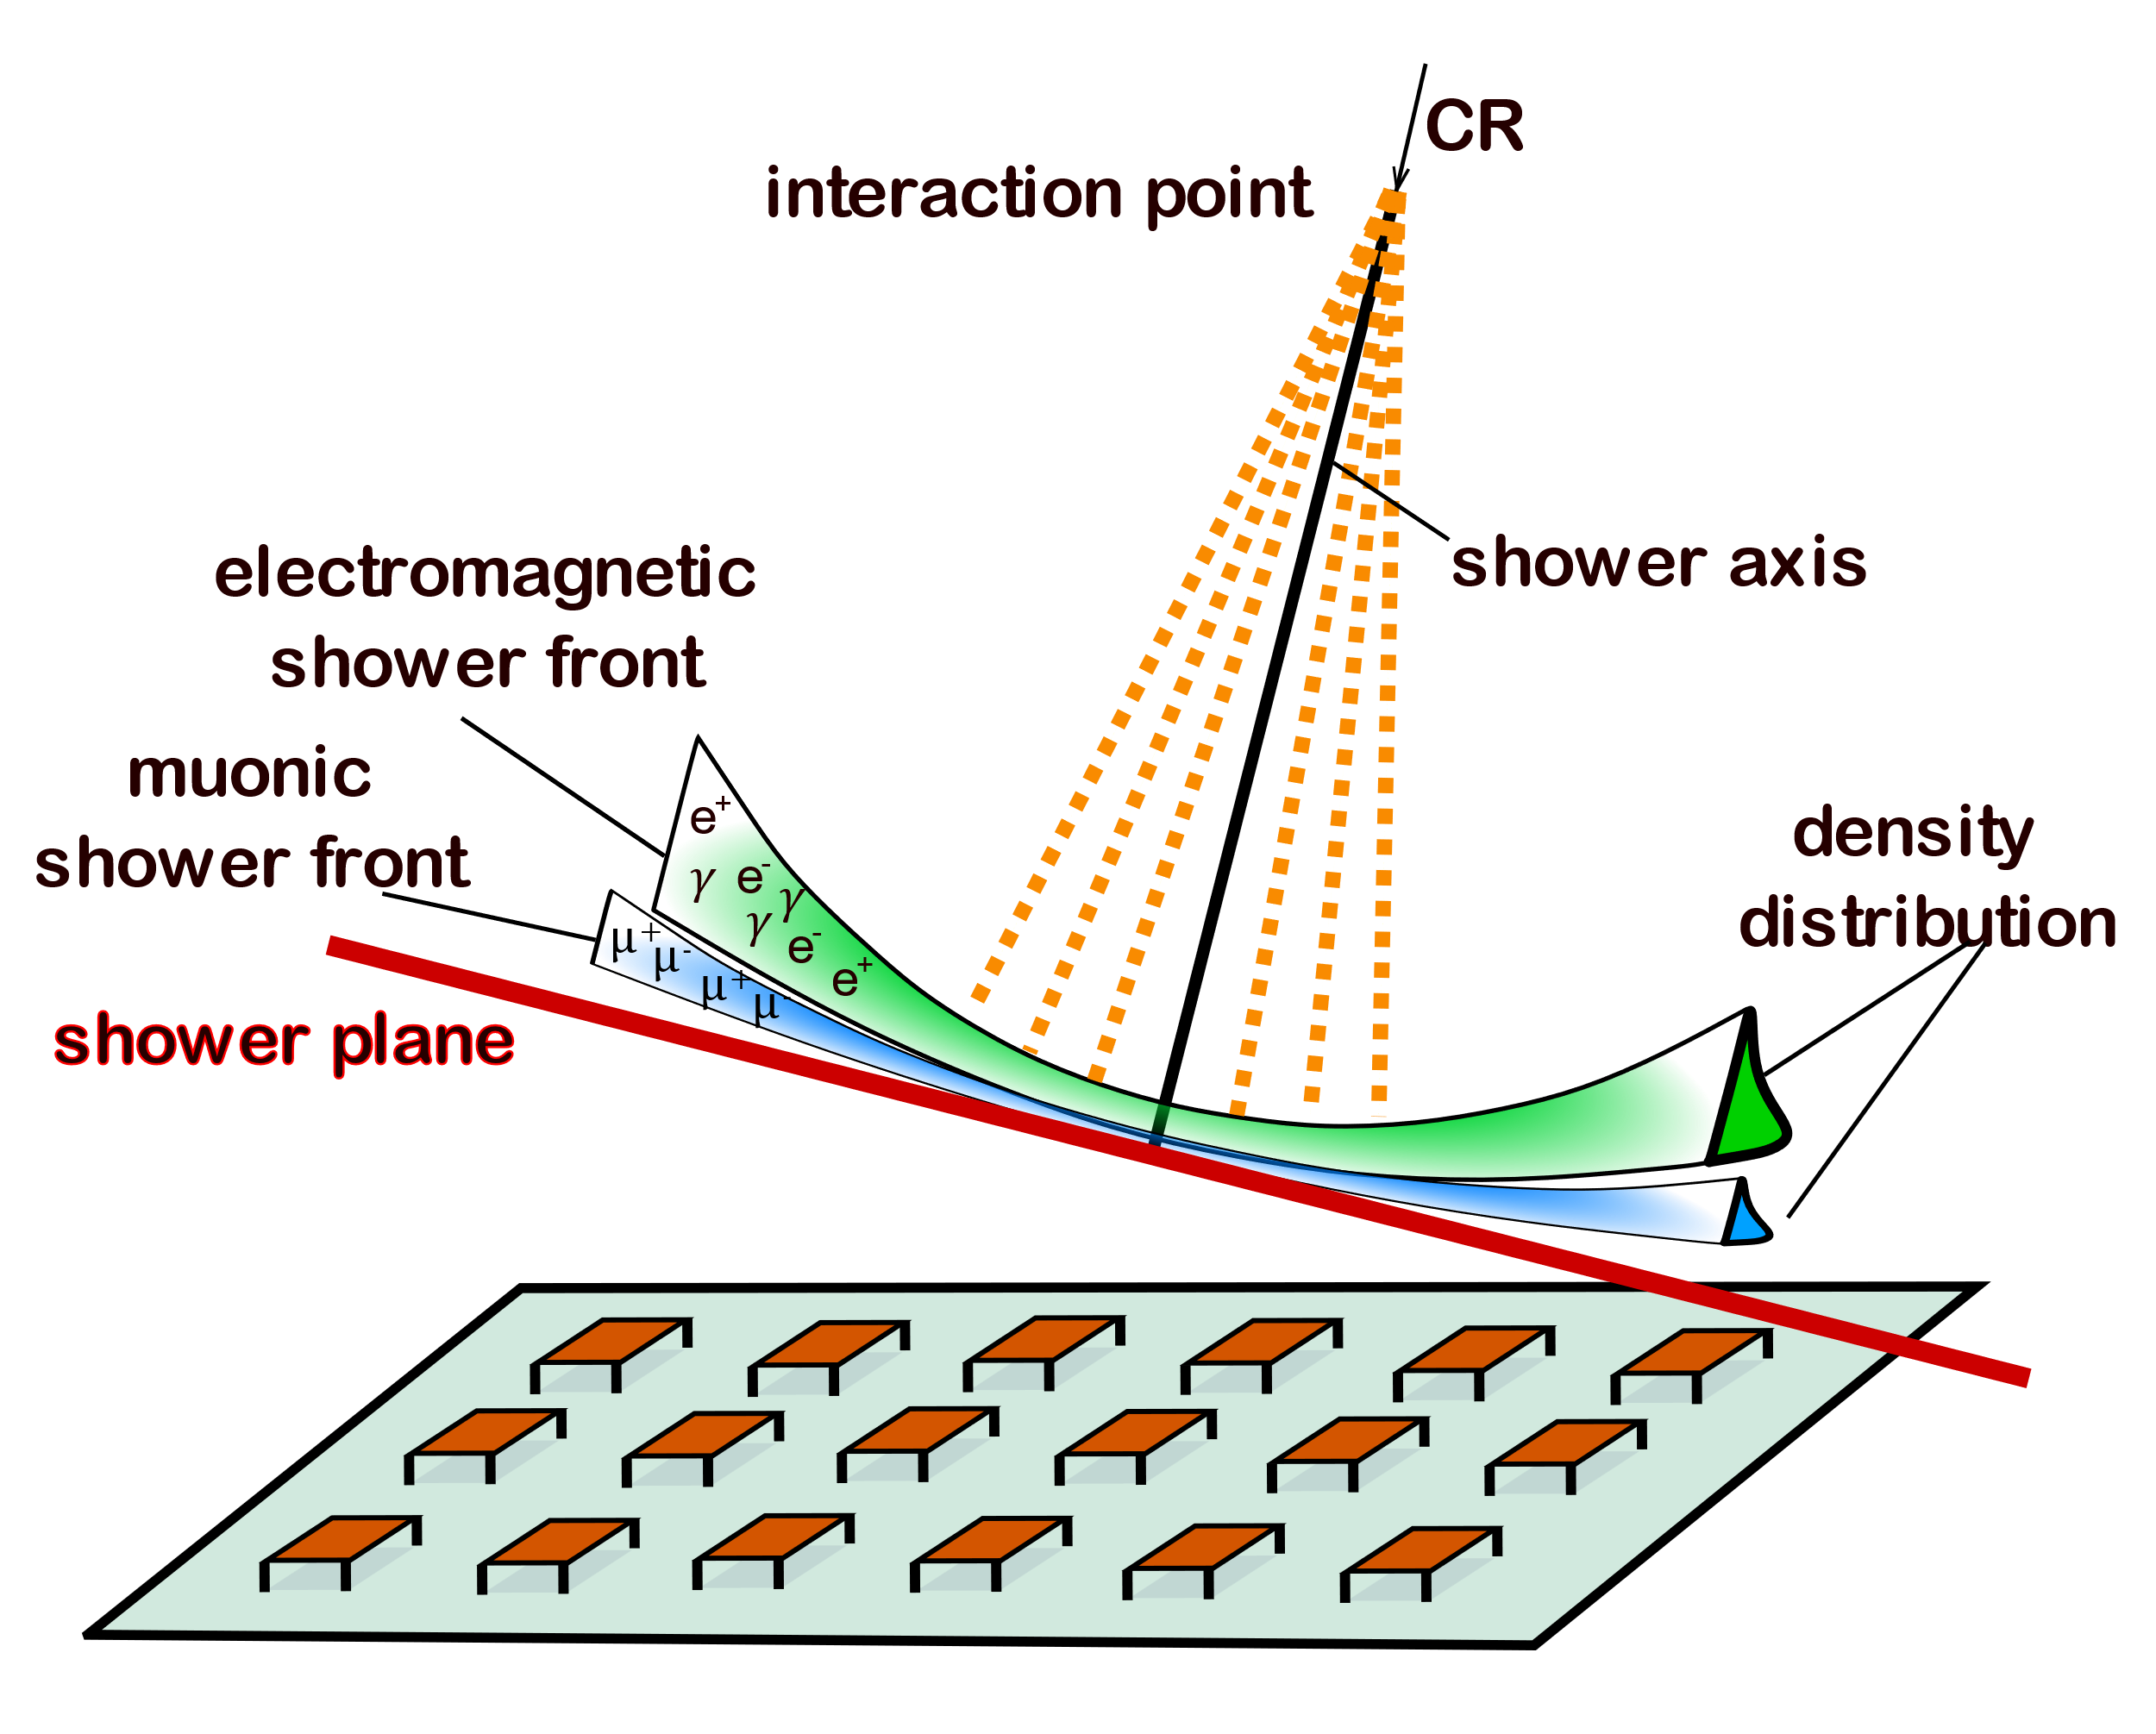
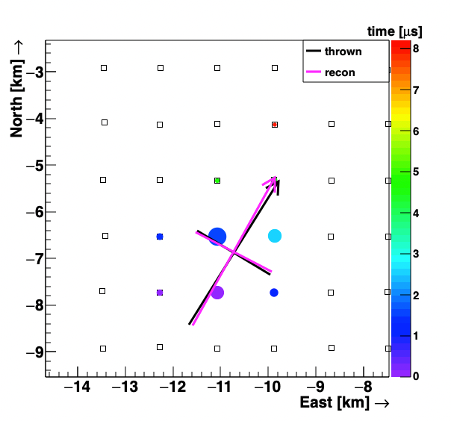
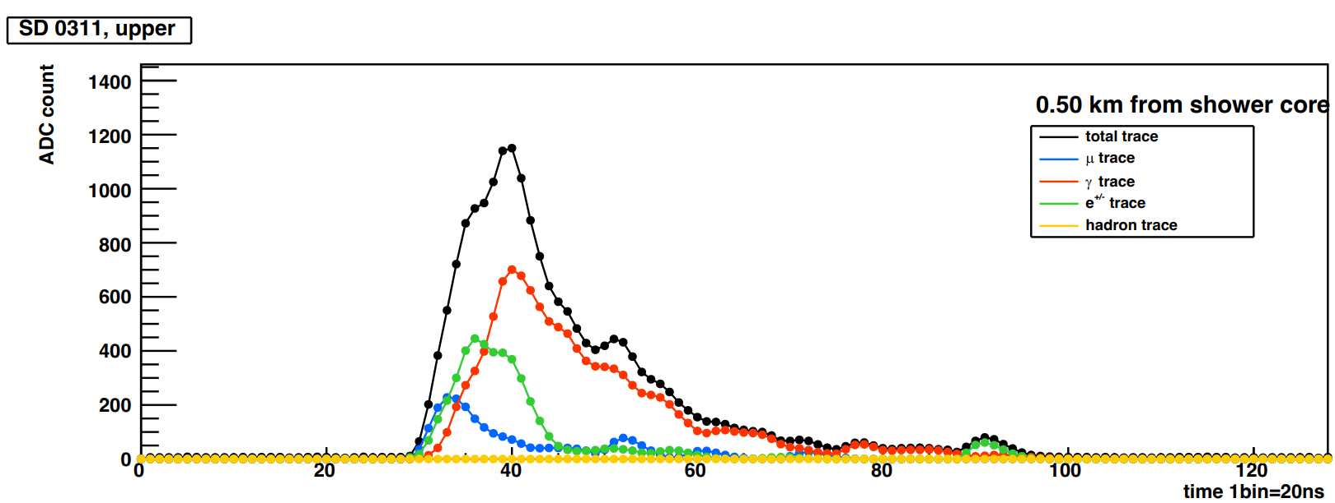
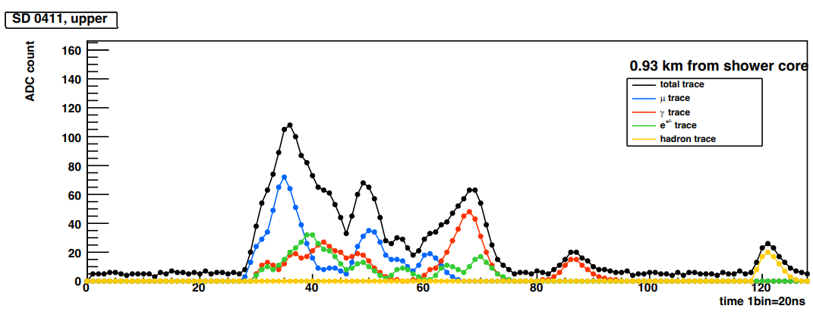
Content of surface detector signals
Arrival times → front curvature → shower direction and core position
Total signal → energy of primary particle
Time trace → front width and structure → development of
  electromagnetic and muonic component
Dynamics (time traces shape) of components encodes
  complex feature
  additional information for energy, direction, core position
0.5 km from core
0.93 km from core
TA SD array
Mass composition information:
• X_{max} information from electromagnetic component
• R_{μ} (number of muons) information from the early part of the time trace (and early shower evolution)
TA MC simulations
K. Fujita, 2024

Slide 7
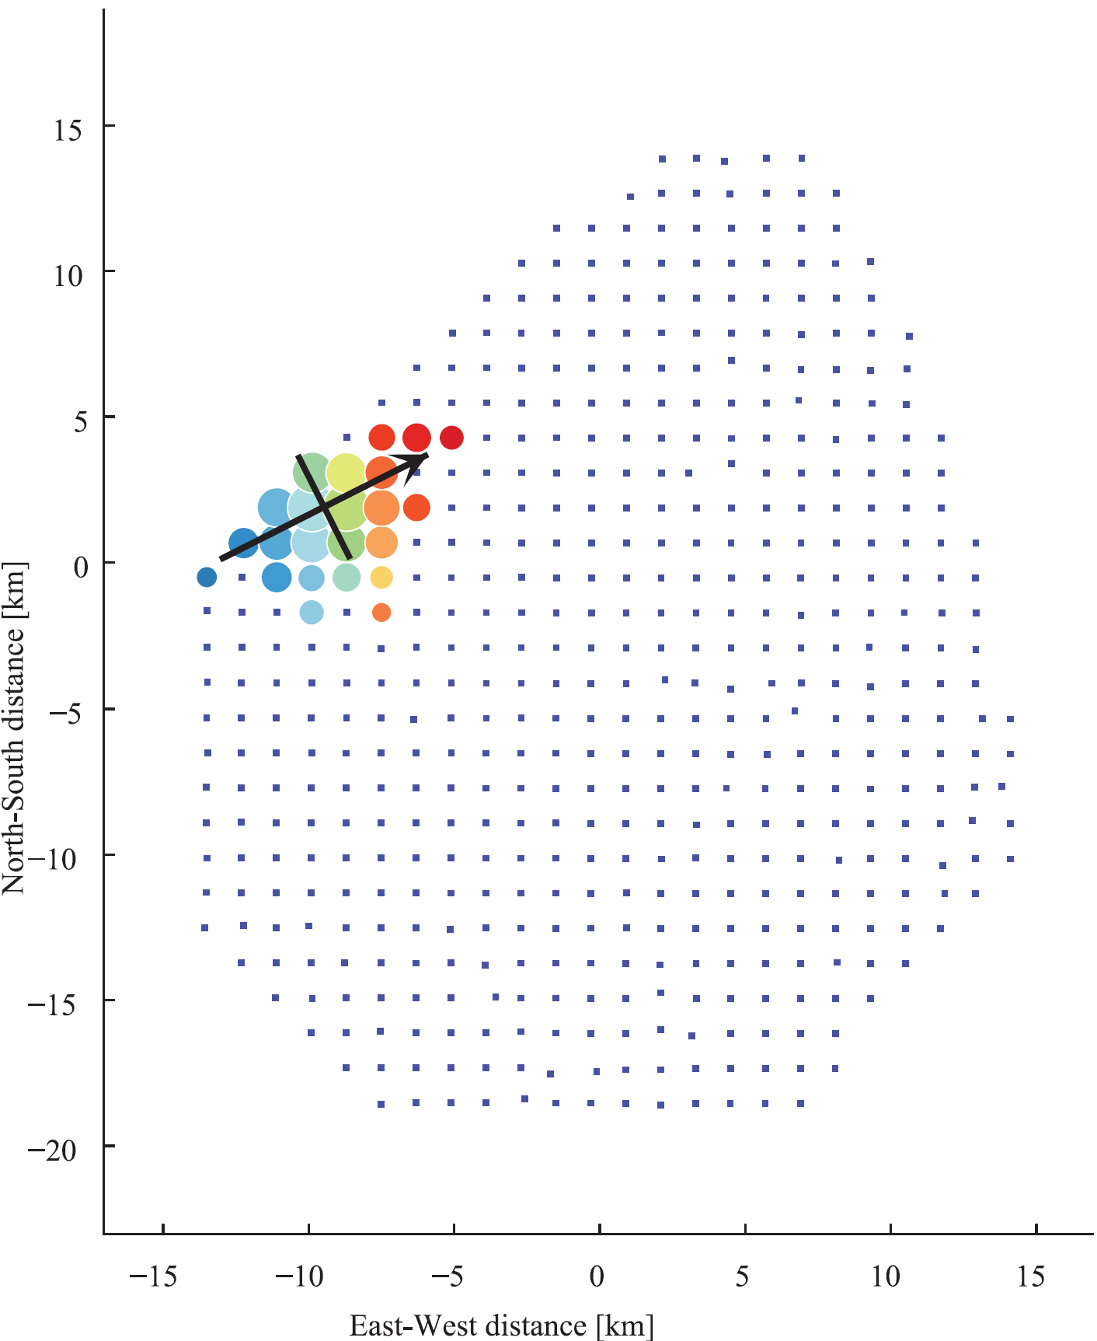
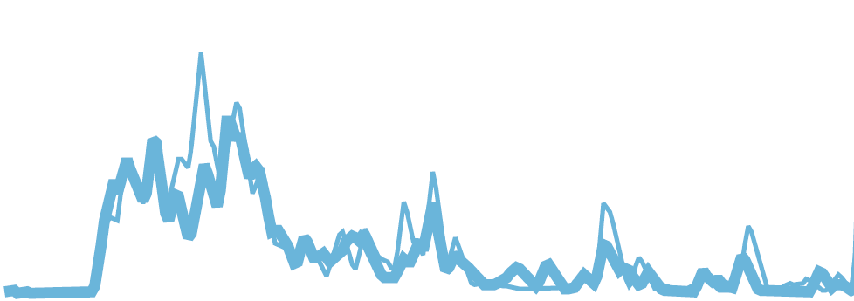
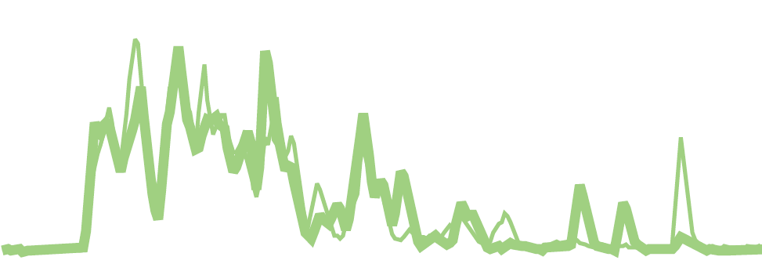
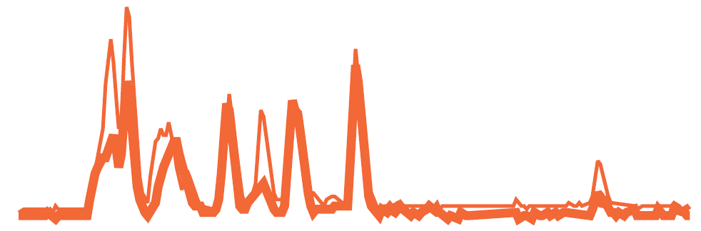
DNN conceptual scheme
7x7 detectors
Input:
7x7 space features
Arrival time
t_{arrv, i}
S_{tot, i}
C_{det, i}
Total signal
Detector status
Detector position (X, Y, Z)
X_{det, i}
Y_{det, i}
Z_{det, i}
Time
features
Space
features
Residual connections
Flatten
layer
Fully
connected
layer
1D convolution
Output:
…
…
+
+
Energy
…
…
…
Direction
…
Input: 7x7 time traces
…
+
…
…
Core
…
Xmax
+
7x7x16
Mass
Kernels
2D convolution
128 bins
Time features extraction
DNN
10 time + 6 space features for each 7x7 detectors
Spatial correlation
DNN

Slide 8
AixNet DNN architecture
AixNet was originally developed by Auger collaboration (M. Erdmann, J. Glombitza, D. Walz, 2018):
S_{tot,i}, t_{arr,I} , C_{i} X_{i}, Y_{i} , Z_{i} (7, 7, 6)
Time feature extraction DNN consists of 3 layers of 1D CNN
  Kernel size and stride should be adjusted for each layer
  Typically: kernel size = 7, and stride = 4
  Use 2 time traces
Spatial correlation DNN consist of 7 layers Depthwise Separable Convolution CNN:
  performs spatial convolutions (2D) separately on each of 7x7 “feature” map
  correlating all feature maps pixel-wise
  Skip (residual) connections concatenate output with input of previous layer
Fully-connected layer (FC) transforms flattened features to predicted quantities:
  E(1), core axis (3), core position(2), X_{max}(1), mass vector(4)
Time tracei (7, 7, 128, 2)
Conv3D, kernel(1x1xk), stride (1, 1, s)
x3
Time features (7, 7, 10)m
Concatenate (7, 7, 16)m
SepConv2D (3x3) (7, 7, 16)m
x7
Concatenate (7, 7, 32)m
Flatten (7x7x 2048)m
FC (11 of features to learn)m

Slide 9
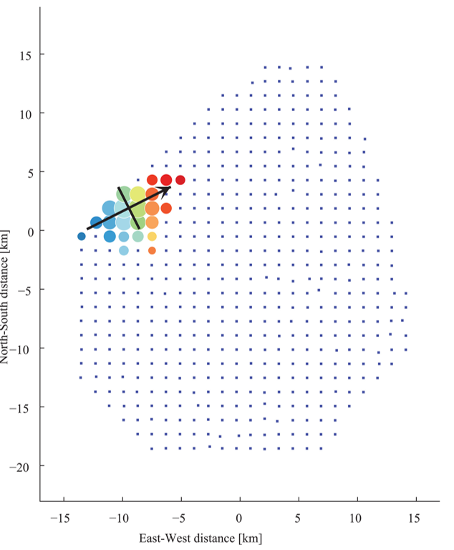
Event’s tiles
Each event is represented as NxN tile of detectors
7x7 vs 9x9 have similar results
  Use 7x7 to save memory and calculation time
Tile is centered on detector with largest integrated signal
Mask central detector (by zeros) because of:
  strongest signal → saturation
  closest to the core → MC might not correctly model signal
Some detectors in the tile might be broken or not exist (border case):
  Missing information reduce accuracy of reconstruction
7x7 tile

Slide 10
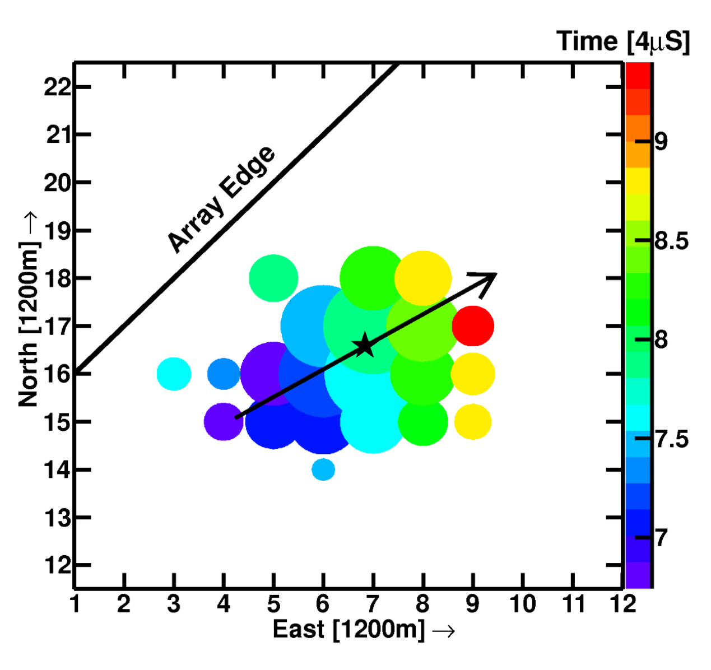
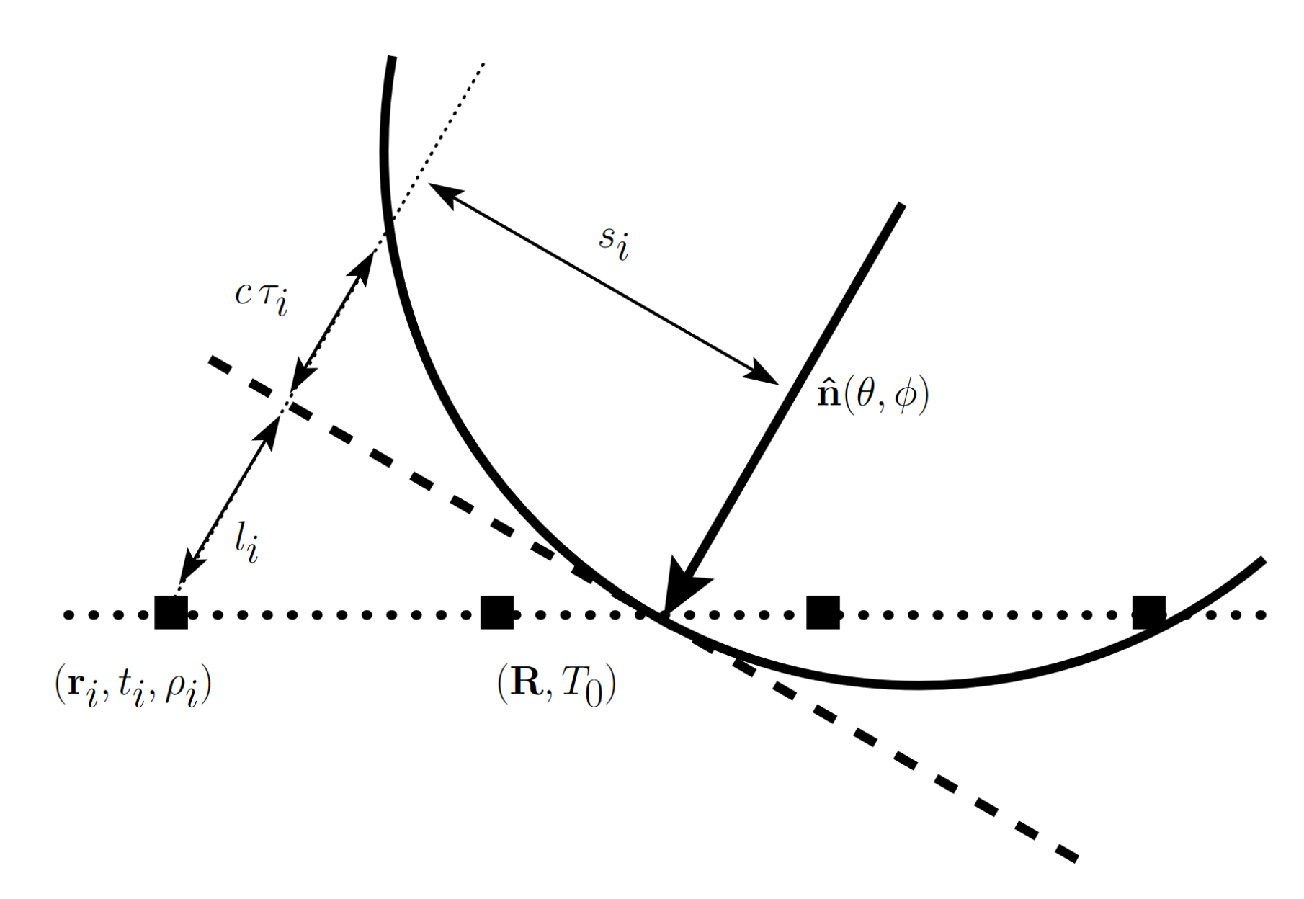
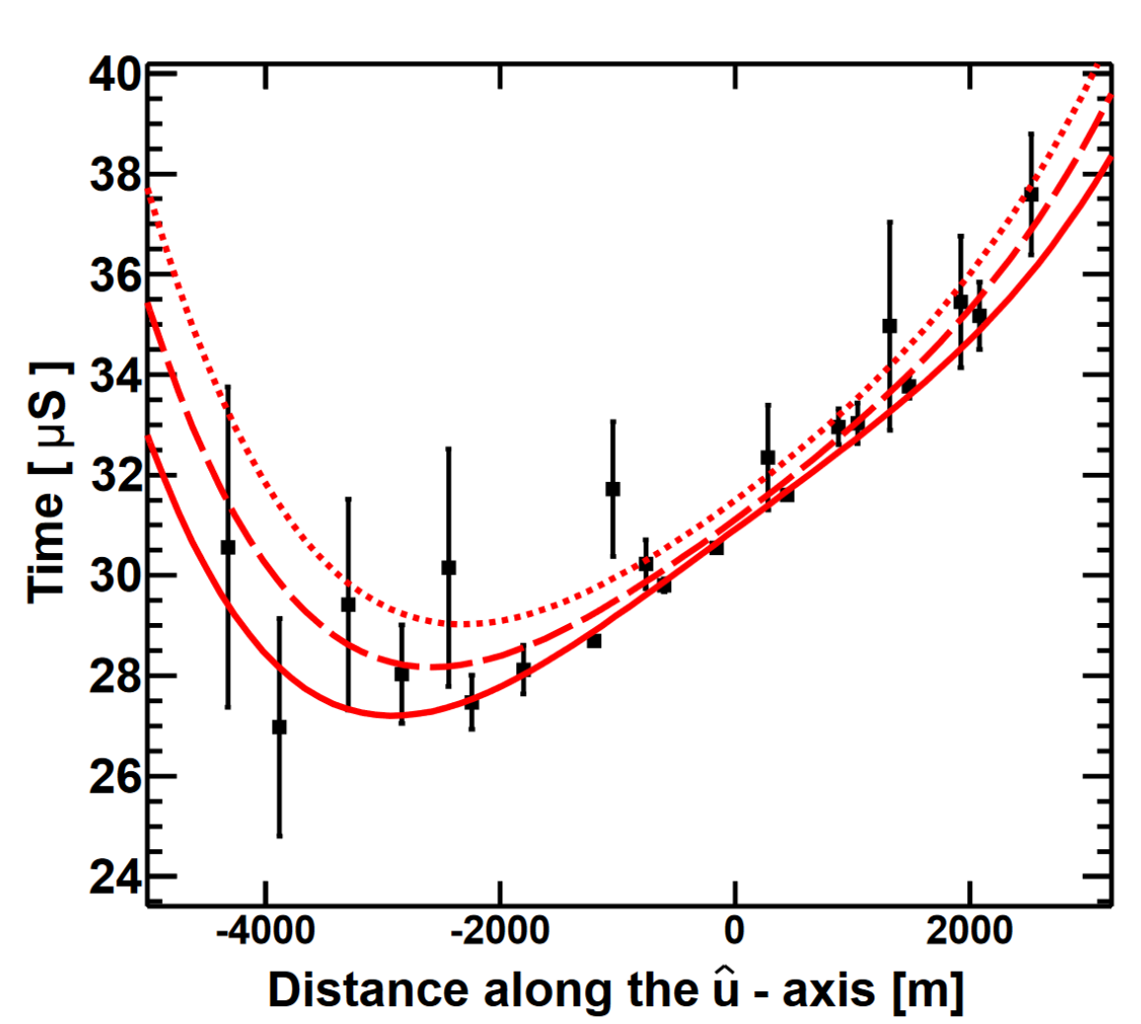
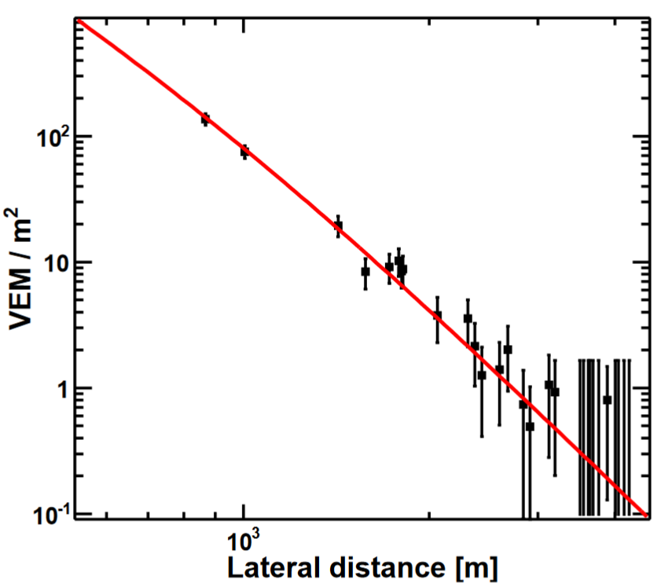
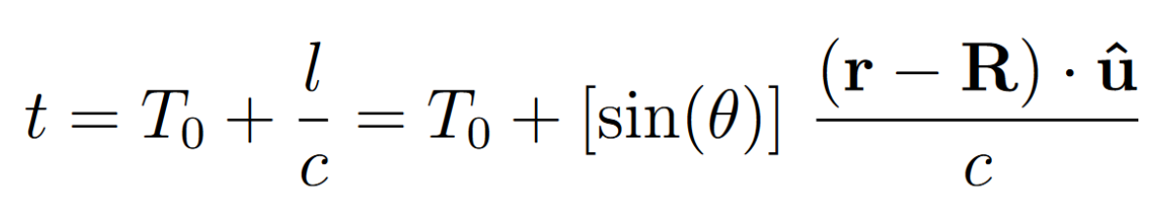
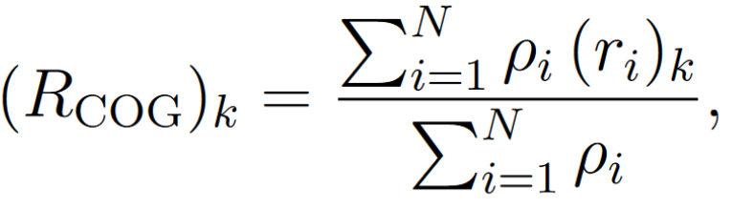
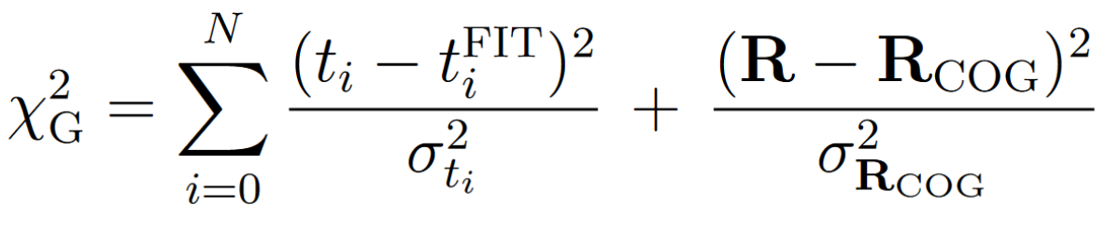
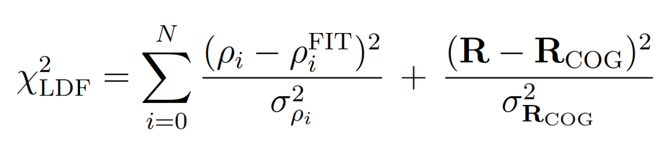
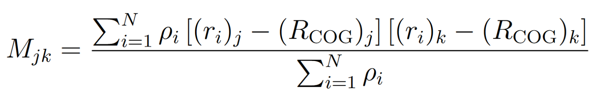
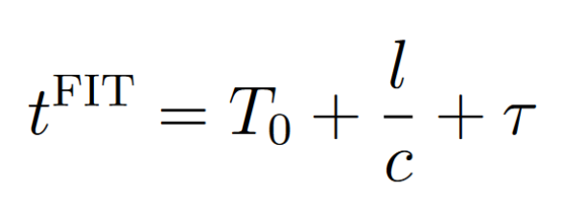
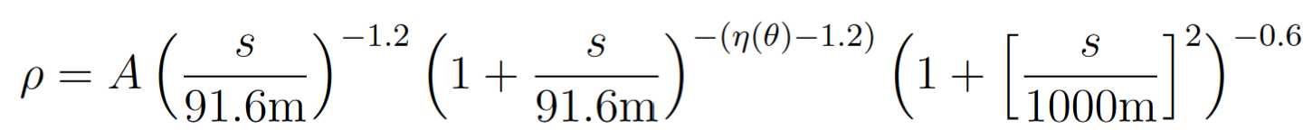
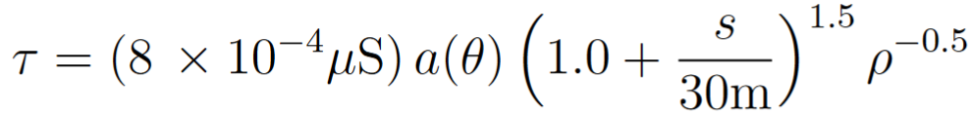
Standard reconstruction
Standard reconstruction is parameter fitting of set of phenomenological functions via χ² minimization on total signal and arrival times data:
1. Geometry estimates:
Core position
Shower axis projection
2. Plane wave front estimates:
Arrival time T₀
Zenith angle sin(θ)
3. Time fit minimization:
Minimization against core, zenith angle, arrival time
Linsley time delay function
4. Lateral distribution fit:
Minimization against core, LDF scale function
LDF AGASA function
x

Slide 11
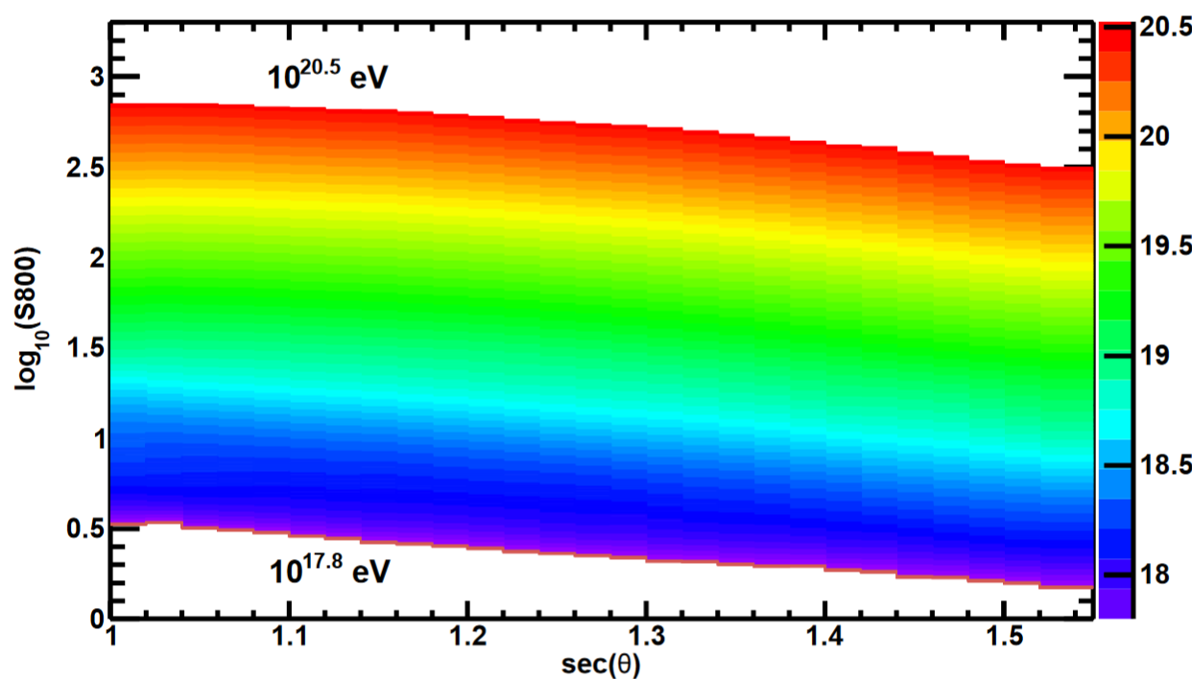
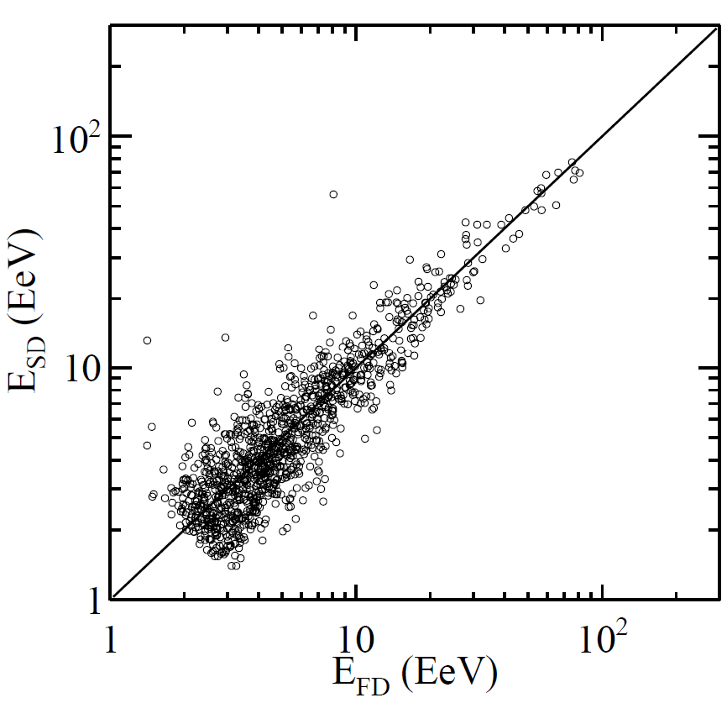
Standard reconstruction
1. First energy estimation:
Energy evaluated from Energy Estimation Table using reconstructed sec(θ) and S800 = ρ(800 m)
Energy Estimation Table is build from large statistics MC set with characteristics of real data by using standard reconstruction
MC dataset with QGSJET-II-03 interaction model and pure proton composition has been used
TA SD Energy Estimation Table,
CORSIKA MC simulations with QGSJET-II-03 for protons
2. Energy scale calibration
First energy estimation is scaled using calibration of SD against the FD measurements on hybrid data
E_{SD} scaled 1/1.27 to FD Energy
TA collaboration, 2023
Other reconstruction methods:
Constant intensity cuts (CIC) doesn’t use MC
CIC agrees with results of standard reconstruction (see Jihyun Kim’s talk)

Slide 12
MC data set details
Spectral quality cuts
CORSIKA 7.3500 simulations
QGSJet-II-04
p, He, N, Fe (0.5 M each)
1000 x 26 x 4 x 20 ~ 2 M events
  1000 Corsika showers per energy bin
  26 energy bins
  4 elements
  20 reshuffling per shower
Energies: (1 EeV, 300 EeV), E^-1 distribution, 26 bins
Zenith angles: < 70 deg, isotropic distribution
Training/validation: 0.9/0.1
Test set ~ 0.5 M
Standard spectral quality cuts
Cut | Efficiency, % | Combined, %
N_{SD} ≥ 5 | 89.82 | 89.82
θ < 45° | 59.08 | 52.75
D_{border}≥ 1200 m | 71.28 | 38.43
χ²_{G}/d.o.f. < 4, χ²_{LDF}/d.o.f. < 4 | 80.64 | 34.07
(σ²_{θ}+ sin²θ σ²_{φ})^{(1/2)} < 5° | 87.43 | 31.60
σ_{S800}/S800 < 0.25 | 69.35 | 29.34

Slide 13
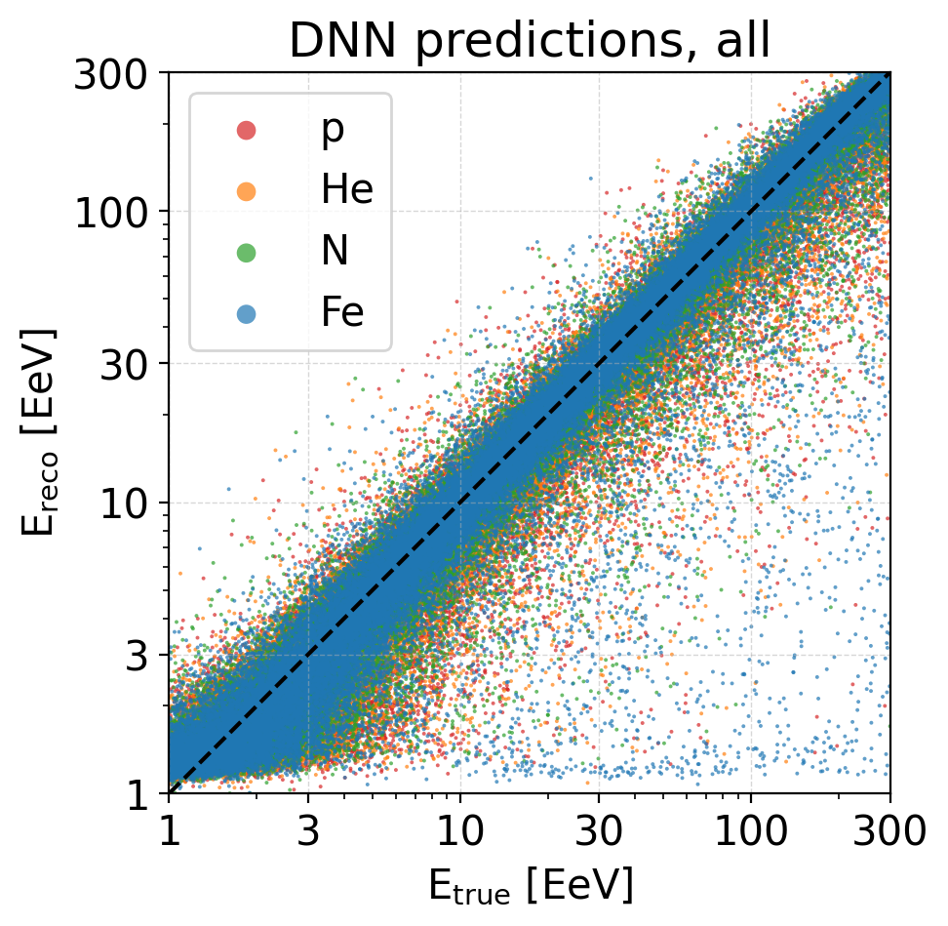
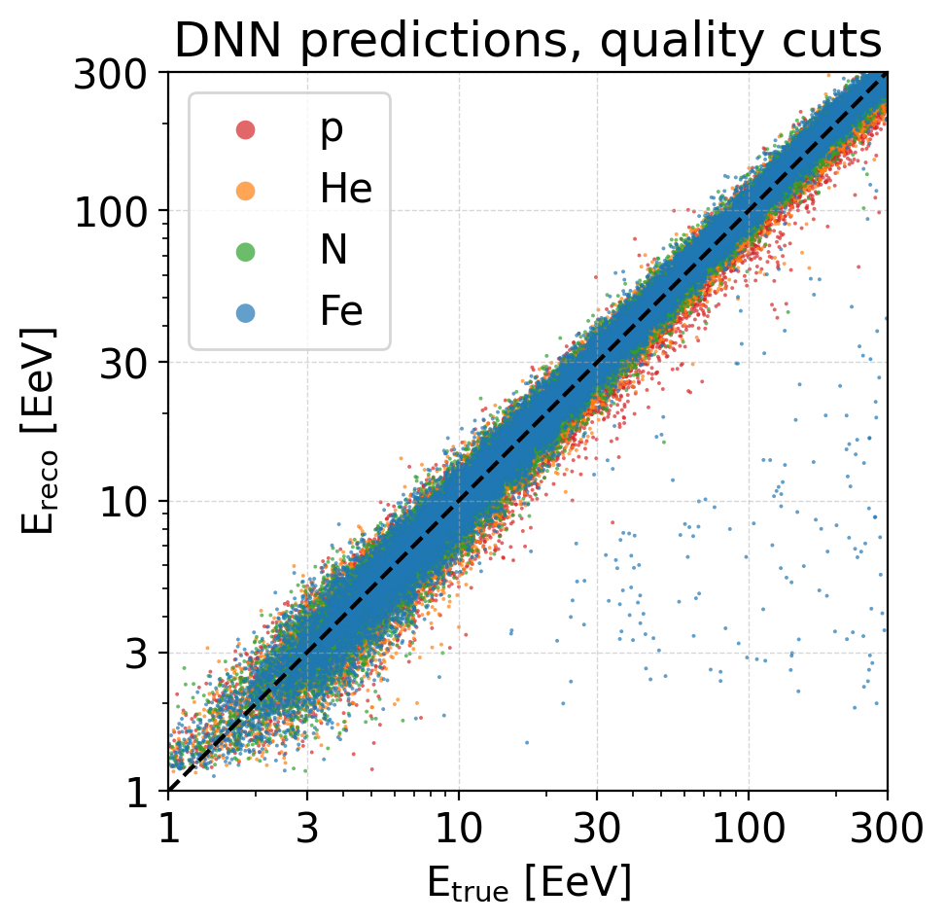
SD energy reconstruction
DNN reconstruction
Offset
Resolution
Quality cuts

Slide 14
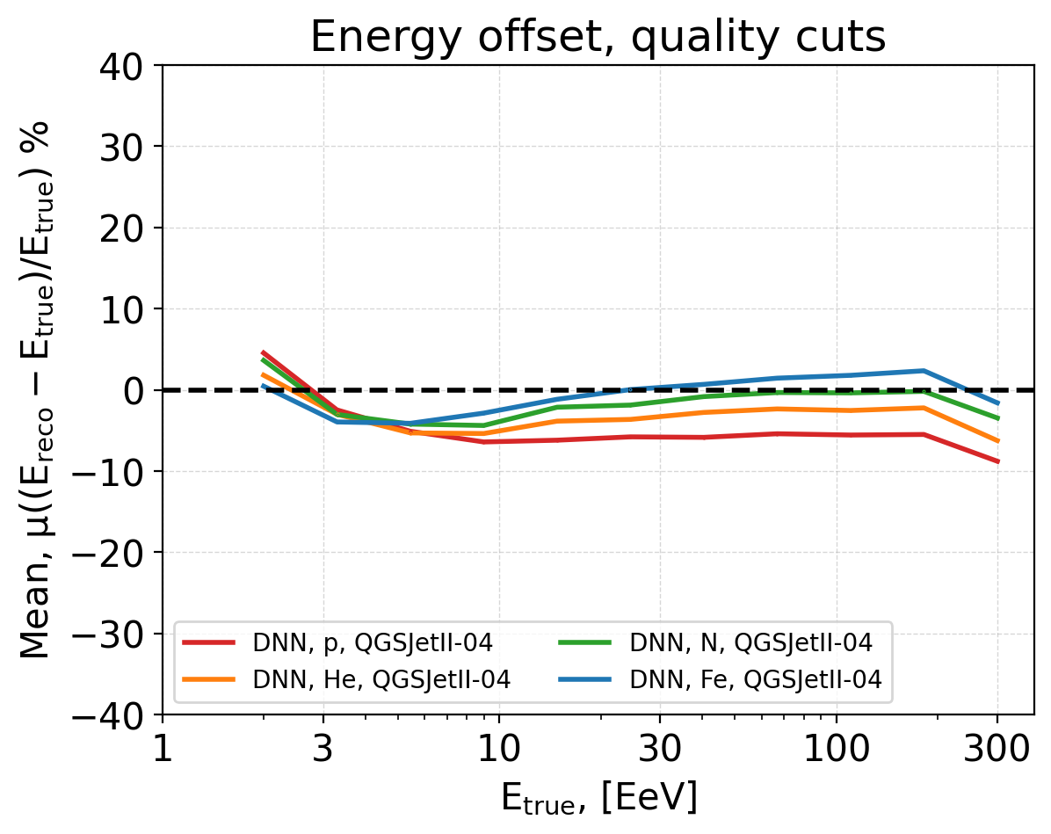
SD energy reconstruction offset
Reconstruction is applied to:
  MC simulations with QGSJet II-04
  events passed quality cuts
DNN trained on QGSJet II-04:
  tends to center around zero bias
  energy offsets -6% – +2.5% (at 200 EeV)
  offset depends on mass of primary with spread 8.5 %
  curves are ordered from proton (red) to iron (blue)
The reconstruction offset depends on interaction model and primary mass and should be fixed by calibration against hybrid events (intrinsically correct interaction and composition)

Slide 15
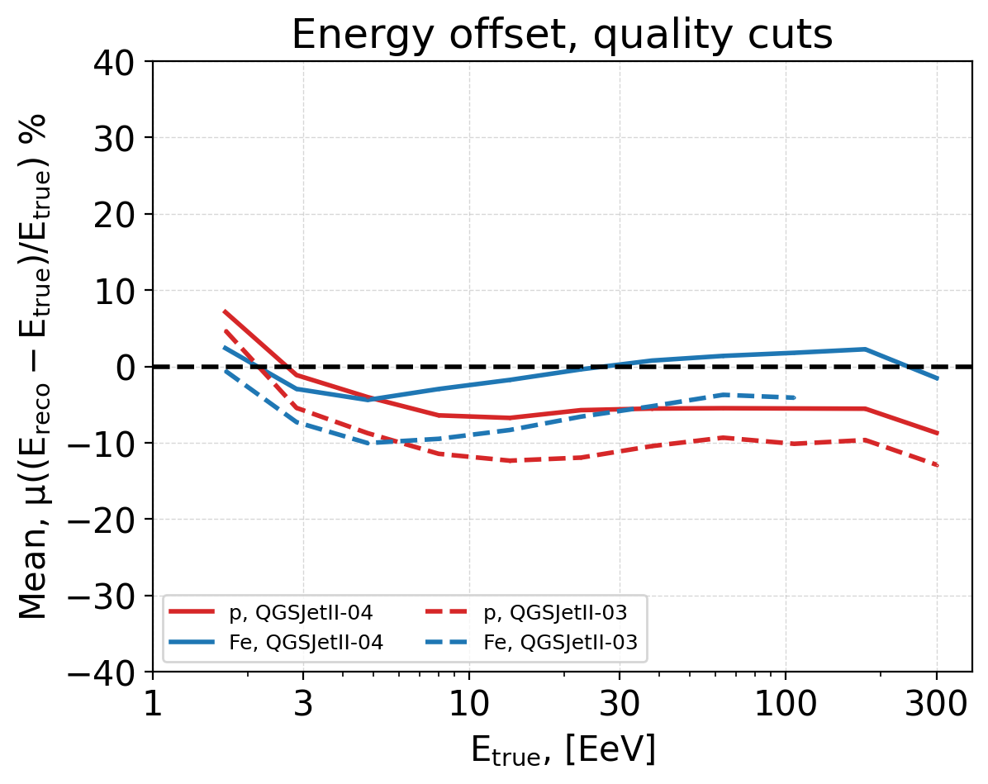
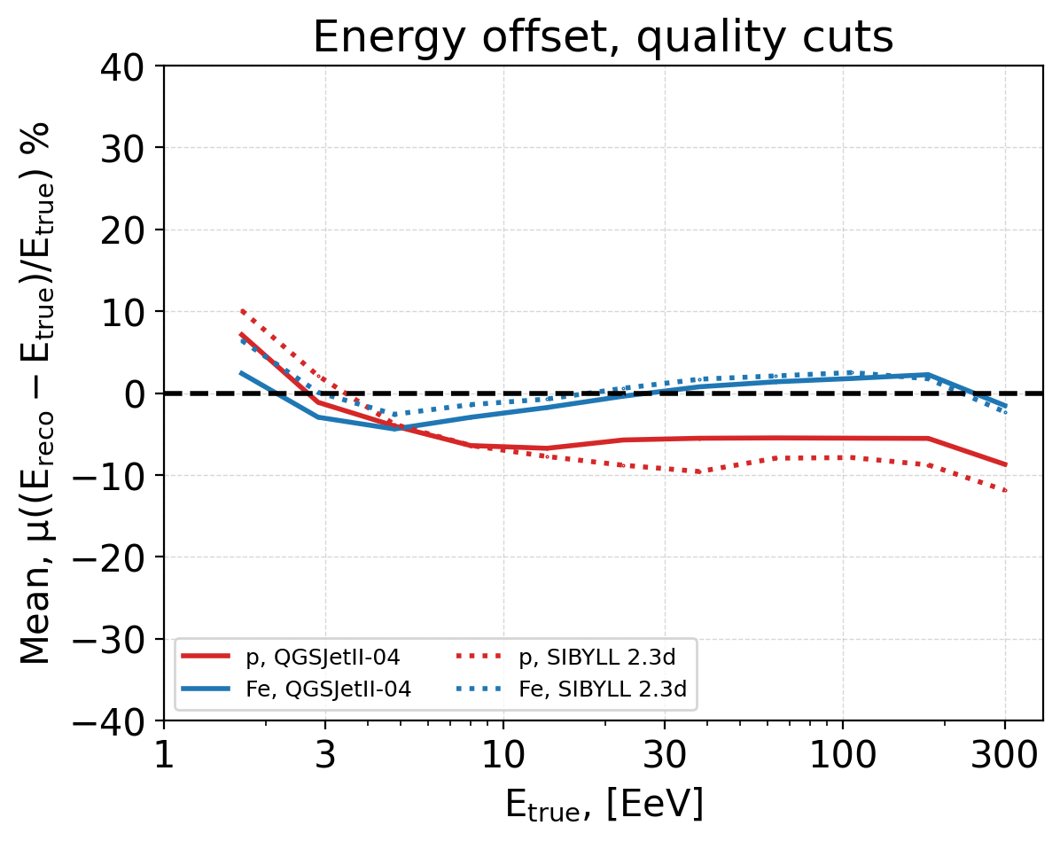
Energy offsets for other models
Comparison with QGSJet II-03
Comparison with Sibyll 2.3d
For interaction models different from training model the offset changed no more than 7%
Offsets between p and Fe are within 10% and ordered the same way

Slide 16
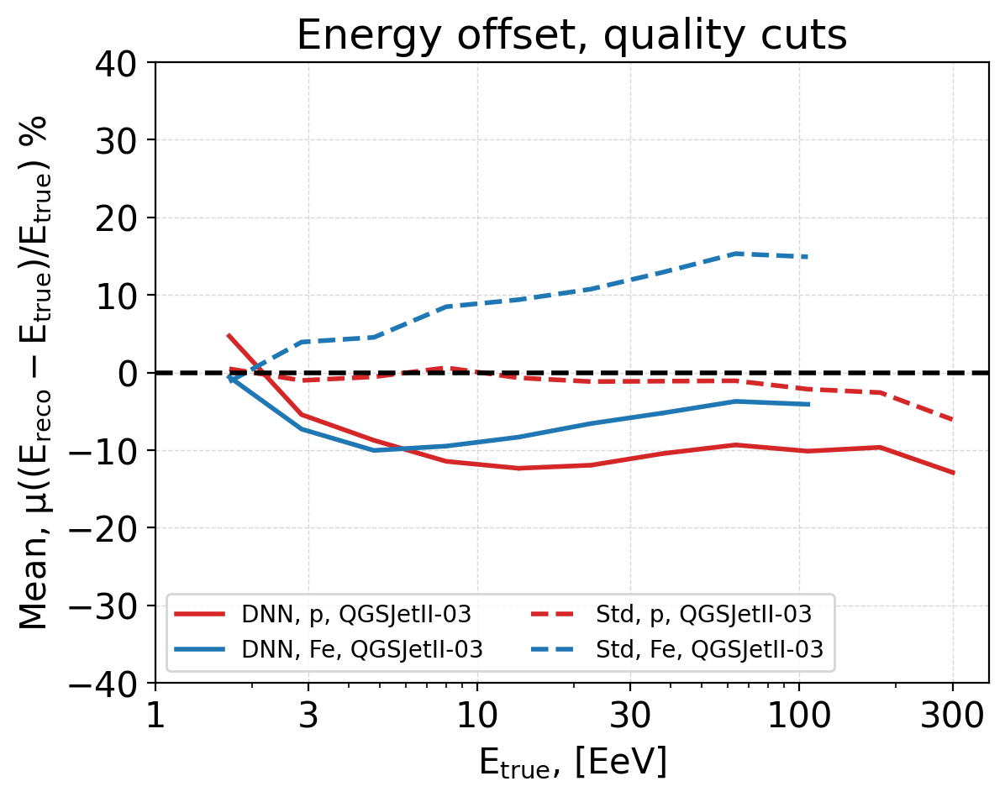
Energy offsets: DNN vs standard reconstruction
Standard reconstruction is adjusted to QGSJetII-03 proton MC simulations
Offset difference between p and Fe for DNN reconstruction are smaller than in standard reconstruction:
  DNN still has composition dependent offset but adapts to it better than standard reconstruction

Slide 17
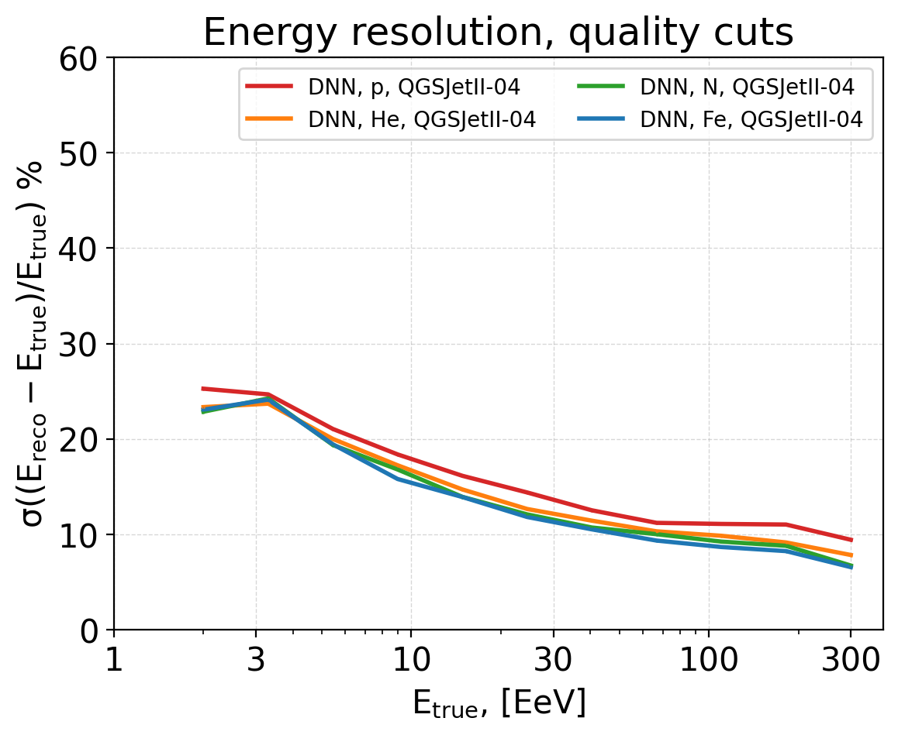
SD energy resolution
The same events as for offset (same caveats)
Resolution (spread) does not depend on offset
Resolution weakly depends on composition
DNN energy resolution:
  protons: 8% - 25%
  He, N, Fe: slightly better than protons

Slide 18
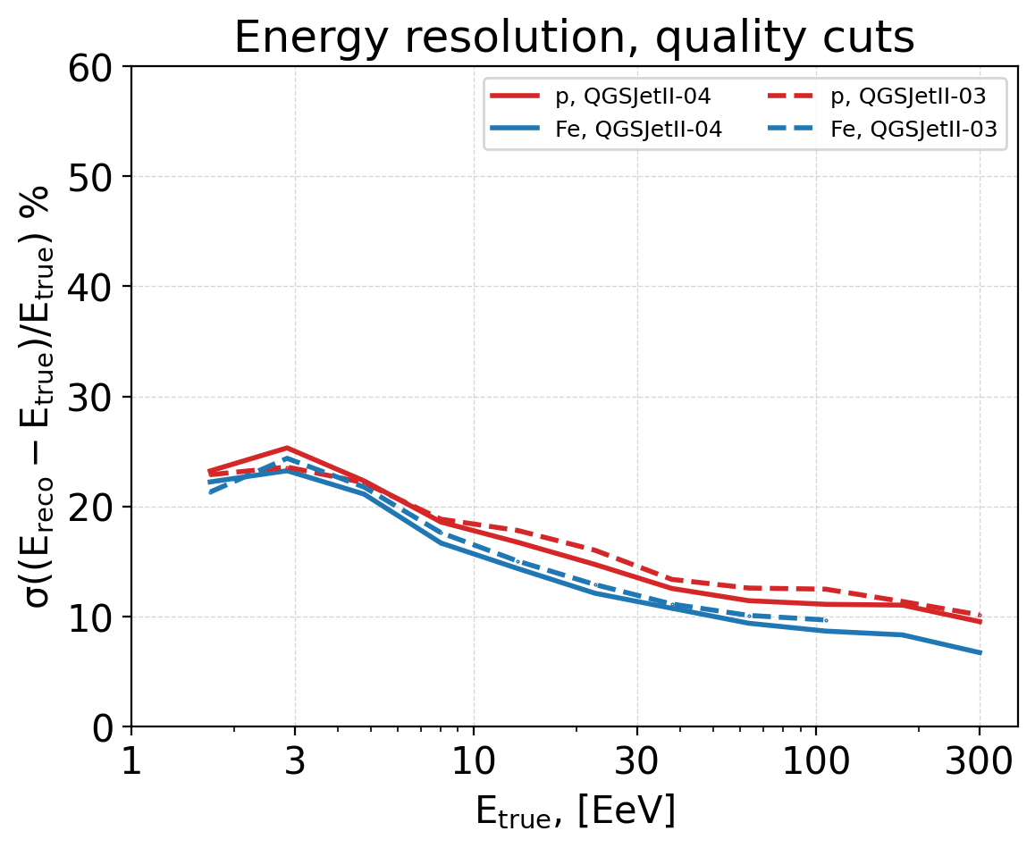
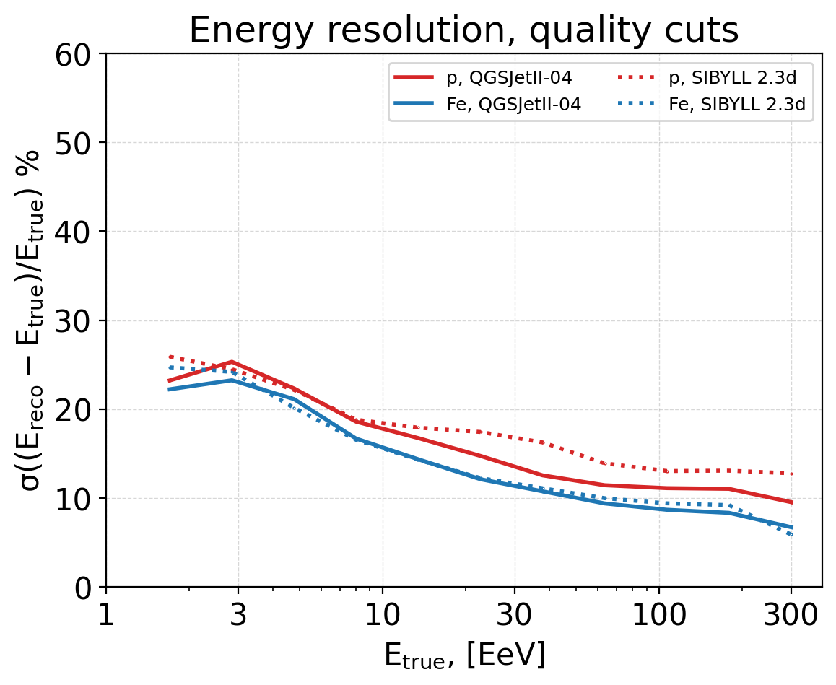
Energy resolution for other models
Comparison with QGSJetII-03
Comparison with Sibyll 2.3d
Resolution is very similar between models with weak dependence on type of primary

Slide 19
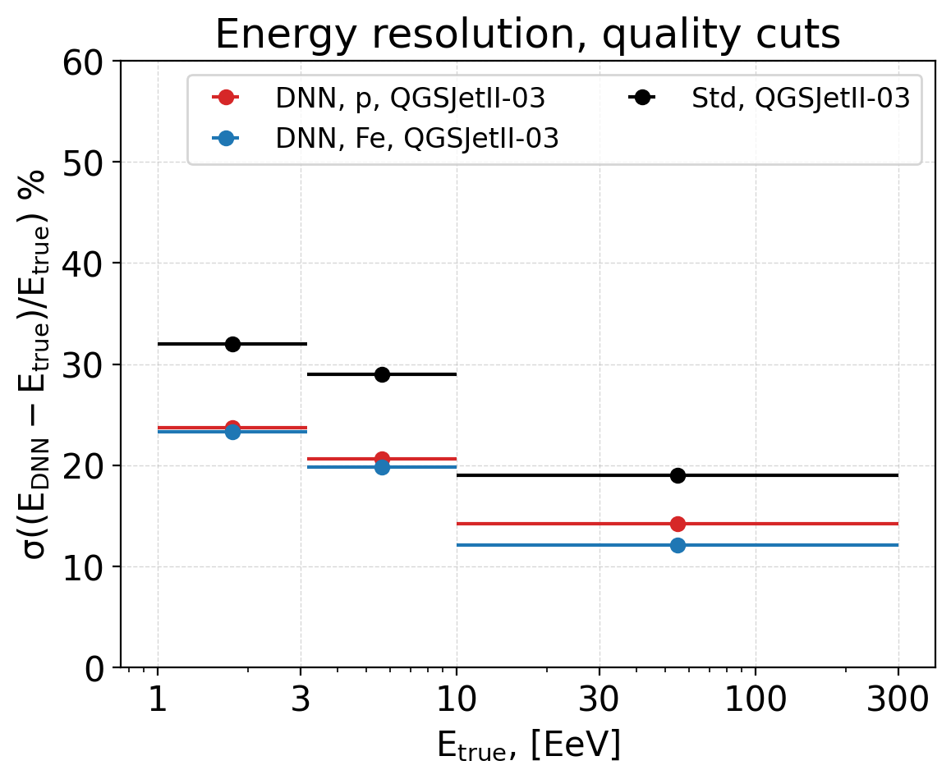
SD energy resolution: DNN vs Std
Resolution is more difficult to take into account than offset, i.e. the smaller the resolution the better
DNN notably improves resolution compared to standard reconstruction

Slide 20
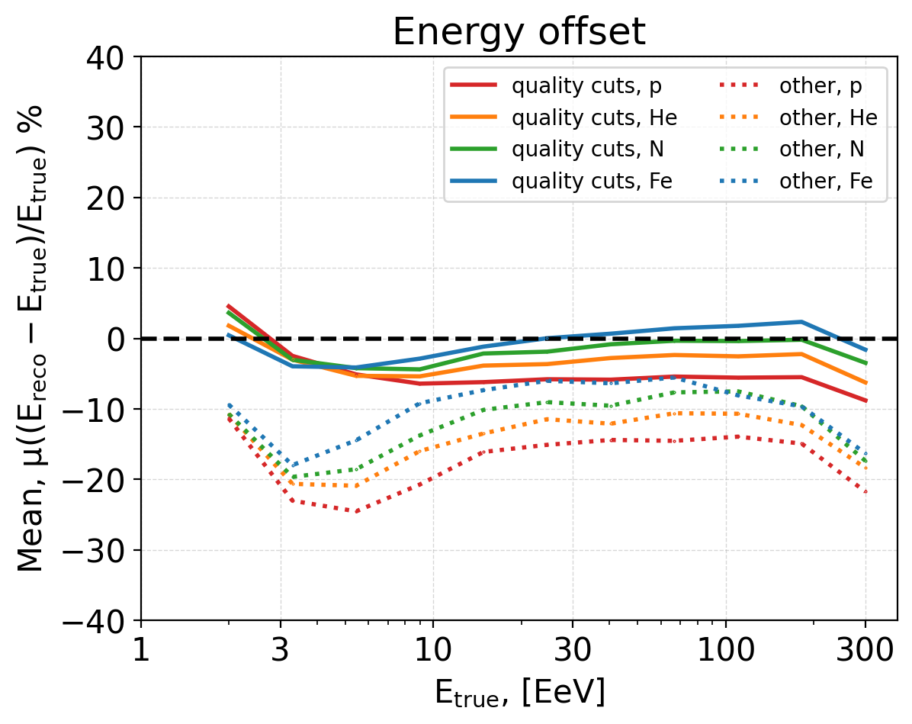
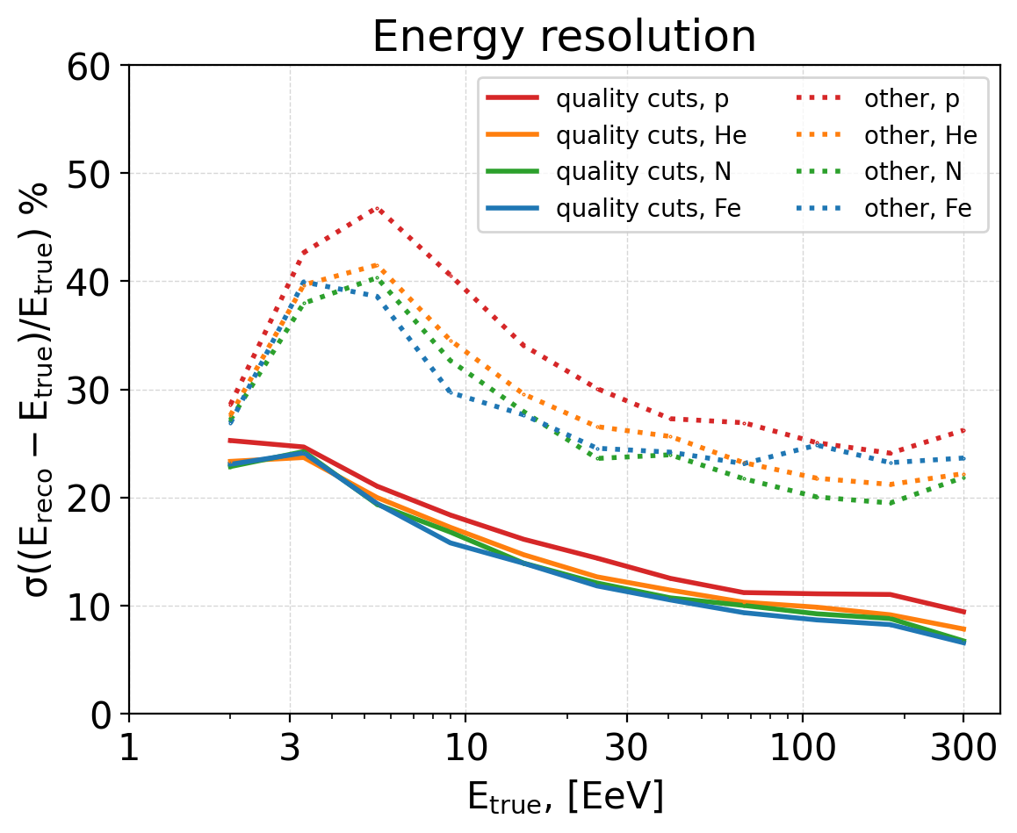
DNN and quality cuts
DNN reconstruction on events that pass quality cuts and on the events that do not (“other”)
DNN improved resolution will allow
Search for more relaxed quality cuts while maintaining the good resolution of the existing reconstruction - increasing statistics

Slide 21
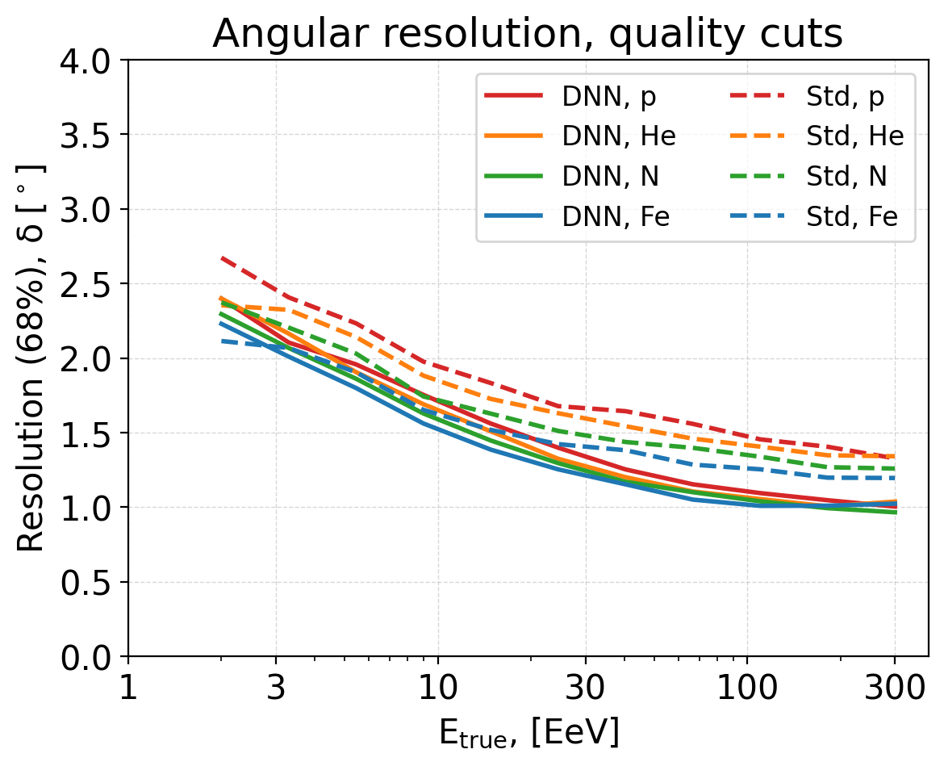
Directional reconstruction
Standard reconstruction resolution:
  protons 2.6° - 1.4°
  He, N better than p but worse than Fe
  iron 2.3° - 1.2°
DNN angular resolution:
  protons: 2.5° - 1.0°
  He, N better than p but worse than Fe
  Iron slightly (<0.1°) better than protons
Angular resolution improves 0.2 °- 0.4°

Slide 22
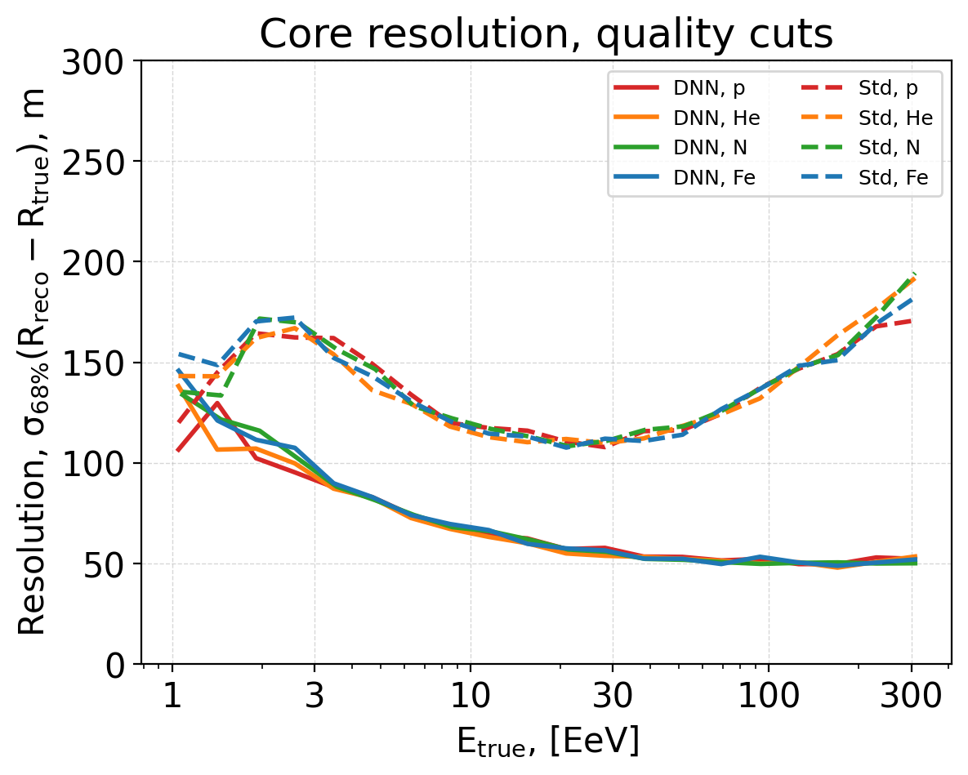
Core position resolution
Reconstruction after quality cut
Standard reconstruction resolution:
  100 – 150 m
DNN core resolution:
  50 – 80 m
Similar for all elements
Core resolution improves 1.5x - 2x using DNN
DNN reconstruction equally good in parallel and perpendicular directions of shower axis projection

Slide 23
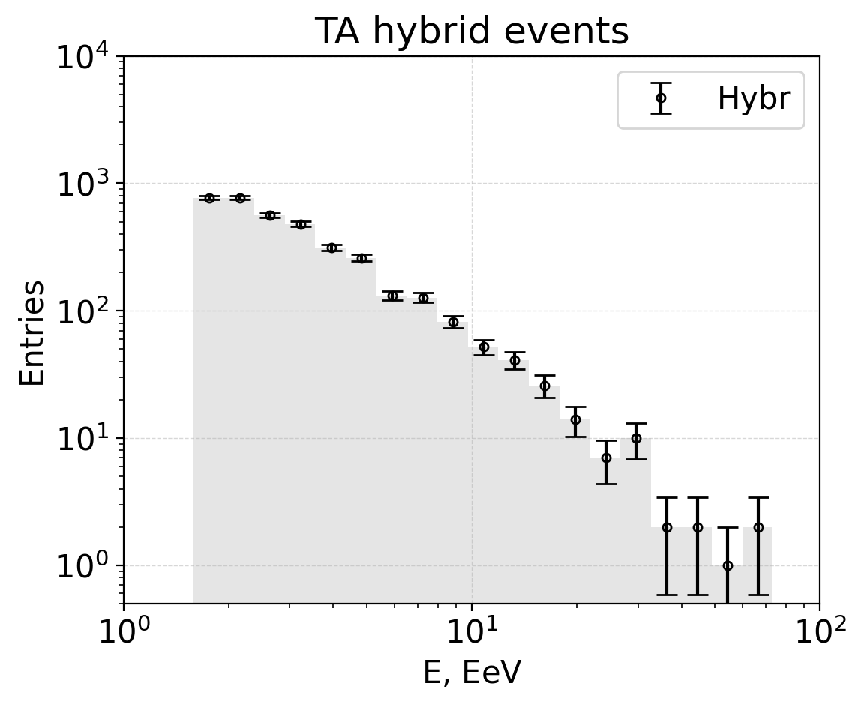
TA Hybrid data
Hybrid data:
Detected both SD and FD
9 years: 2008-05-27 to 2017-11-28
Total 3656 events,
After quality cuts 911 events

Slide 24
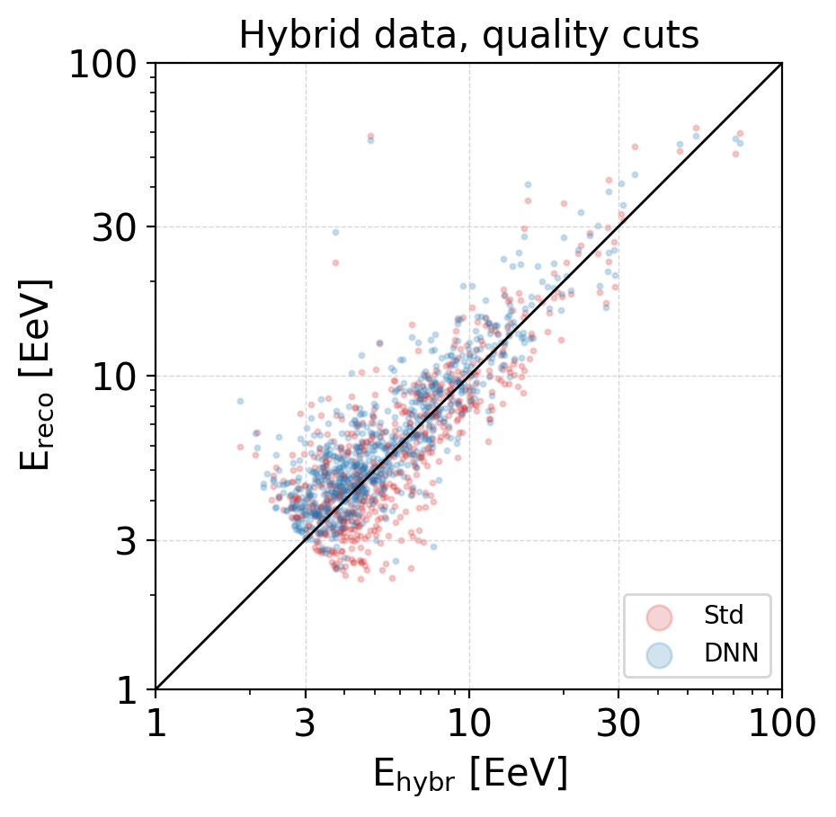
Performance on TA Hybrid data
Hybrid data:
Detected both SD and FD
9 years: 2008-05-27 to 2017-11-28
Total 3656 events,
After quality cuts 911 events
DNN works well on real TA data, with results similar to standard reconstruction

Slide 25
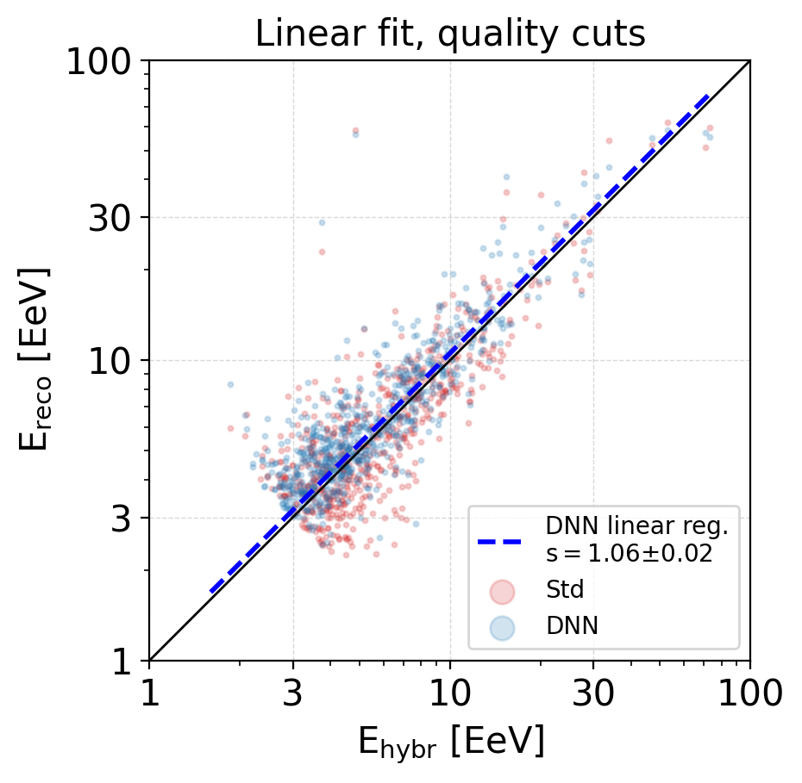
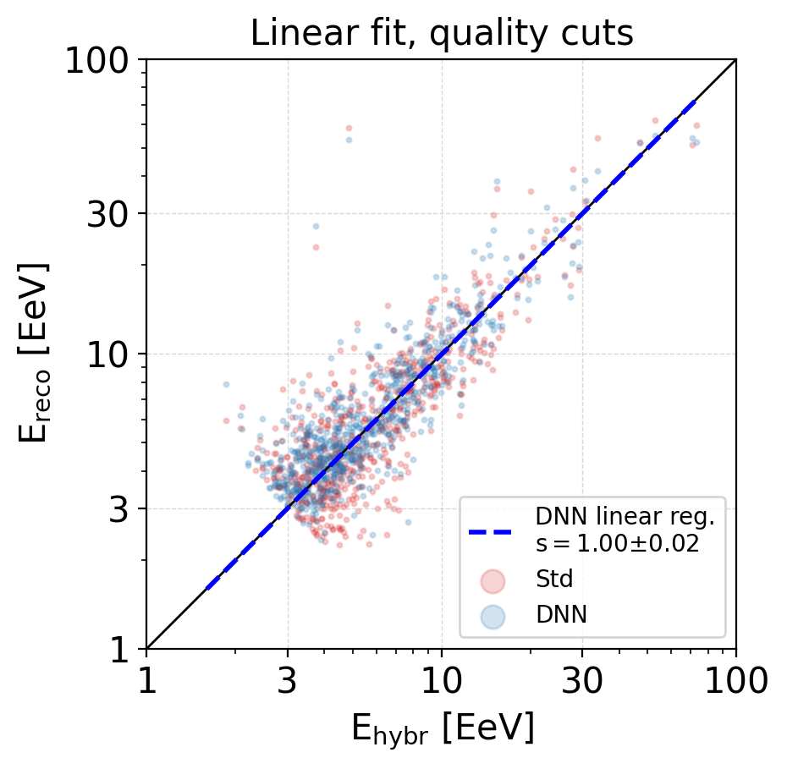
Calibration to FD
DNN * 1/1.06 ⇒
DNN calibrated to FD
Linear regression fit: E_{DNN} = s* E_{hybr}, bias = s - 1
With offset 6% for DNN, the calibration factor for given DNN is s = 1.06
In further application energy estimated with E = E_{DNN}/1.06

Slide 26
Conclusions
We presented a new DNN reconstruction method for the Telescope Array Surface Detector.
DNN improves the accuracy of Standard reconstruction for energy resolution, direction, and core position on events with quality cuts.
Reasonable performance of DNN on events that haven’t passed quality cuts indicates that DNN could perform well on a larger dataset with more relaxed quality cuts.
Validation on TA hybrid data shows that the DNN performs well on real data.
Next steps include developing a new set of quality cuts and accuracy metrics for the DNN to effectively utilize available data while maintaining the accuracy of the reconstruction

